Slide 1

Welcome to TensorFlow!
CS 20: TensorFlow for Deep Learning Research
Lecture 1
1/12/2018
Thanks Danijar Hafner for the logo!

Slide 2
Goals
Understand TF’s computation graph approach
Explore TF’s built-in functions and classes
Learn how to build and structure models best suited for a deep learning project

Slide 3
CS20

Slide 4
Getting Started

Slide 5
import tensorflow as tf

Slide 6
Graphs and Sessions

Slide 7
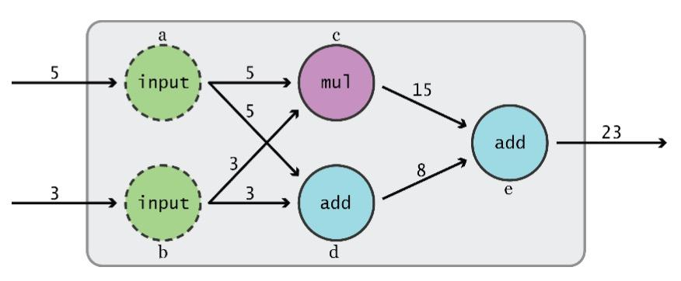
Data Flow Graphs
TensorFlow separates definition of computations from their execution
Graph from TensorFlow for Machine Intelligence
Notes:
How does it do so? By using graphs and sessions

Slide 8
Data Flow Graphs
Phase 1: assemble a graph
Phase 2: use a session to execute operations in the graph.
Graph from TensorFlow for Machine Intelligence

Slide 9
Data Flow Graphs
This might change in the future with eager mode!!
Phase 1: assemble a graph
Phase 2: use a session to execute operations in the graph.
Graph from TensorFlow for Machine Intelligence

Slide 10
What’s a tensor?

Slide 11
What’s a tensor?
An n-dimensional array
0-d tensor: scalar (number)
1-d tensor: vector
2-d tensor: matrix
and so on

Slide 12
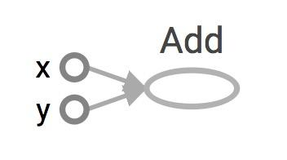
Data Flow Graphs
import tensorflow as tf a = tf.add(3, 5)
Visualized by TensorBoard
Notes:
More about naming them in the next module

Slide 13
Data Flow Graphs
import tensorflow as tf a = tf.add(3, 5)
Visualized by TensorBoard
Why x, y?
TF automatically names the nodes when you don’t explicitly name them.
x = 3
y = 5
Notes:
More about naming them in the next module

Slide 14
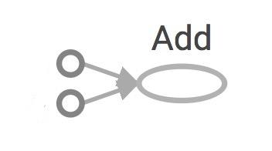
Data Flow Graphs
import tensorflow as tf a = tf.add(3, 5)
Interpreted?
3
Nodes: operators, variables, and constants
Edges: tensors
5
a
Notes:
Different from graphs we might be familiar in which nodes are values, edges are functions

Slide 15

Data Flow Graphs
import tensorflow as tf a = tf.add(3, 5)
Interpreted?
3
Nodes: operators, variables, and constants
Edges: tensors
Tensors are data.
TensorFlow = tensor + flow = data + flow
(I know, mind=blown)
5
a
Notes:
Different from graphs we might be familiar in which nodes are values, edges are functions

Slide 16
Data Flow Graphs
import tensorflow as tf a = tf.add(3, 5) print(a)
3
5
a
>> Tensor("Add:0", shape=(), dtype=int32)
(Not 8)

Slide 17
How to get the value of a?
Create a session, assign it to variable sess so we can call it later
Within the session, evaluate the graph to fetch the value of a

Slide 18
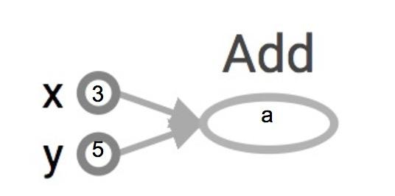
How to get the value of a?
Create a session, assign it to variable sess so we can call it later
Within the session, evaluate the graph to fetch the value of a
import tensorflow as tf a = tf.add(3, 5) sess = tf.Session() print(sess.run(a)) sess.close()
The session will look at the graph, trying to think: hmm, how can I get the value of a,
then it computes all the nodes that leads to a.

Slide 19
How to get the value of a?
Create a session, assign it to variable sess so we can call it later
Within the session, evaluate the graph to fetch the value of a
import tensorflow as tf a = tf.add(3, 5) sess = tf.Session() print(sess.run(a)) sess.close()
>> 8
8
The session will look at the graph, trying to think: hmm, how can I get the value of a,
then it computes all the nodes that leads to a.

Slide 20
How to get the value of a?
Create a session, assign it to variable sess so we can call it later
Within the session, evaluate the graph to fetch the value of a
import tensorflow as tf a = tf.add(3, 5) sess = tf.Session() with tf.Session() as sess: print(sess.run(a)) sess.close()
8

Slide 21
tf.Session()
A Session object encapsulates the environment in which Operation objects are executed, and Tensor objects are evaluated.

Slide 22
tf.Session()
A Session object encapsulates the environment in which Operation objects are executed, and Tensor objects are evaluated.
Session will also allocate memory to store the current values of variables.
Notes:
Note that sessions deal with memory allocation

Slide 23
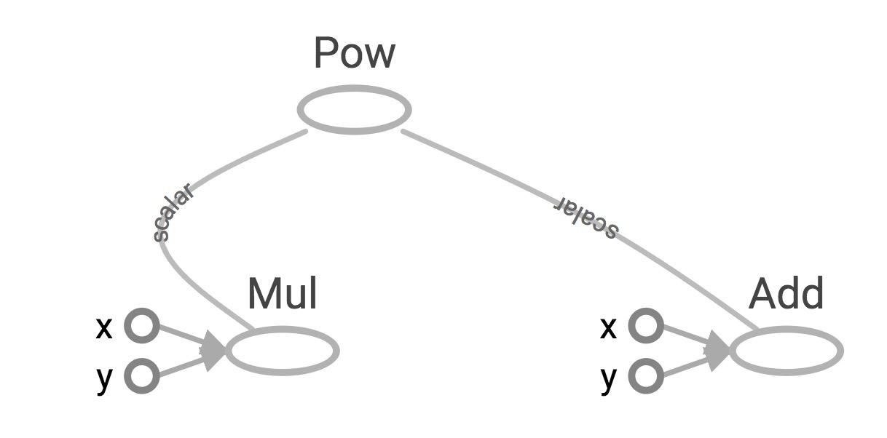
More graph
Visualized by TensorBoard
x = 2 y = 3 op1 = tf.add(x, y) op2 = tf.multiply(x, y) op3 = tf.pow(op2, op1) with tf.Session() as sess: op3 = sess.run(op3)

Slide 24
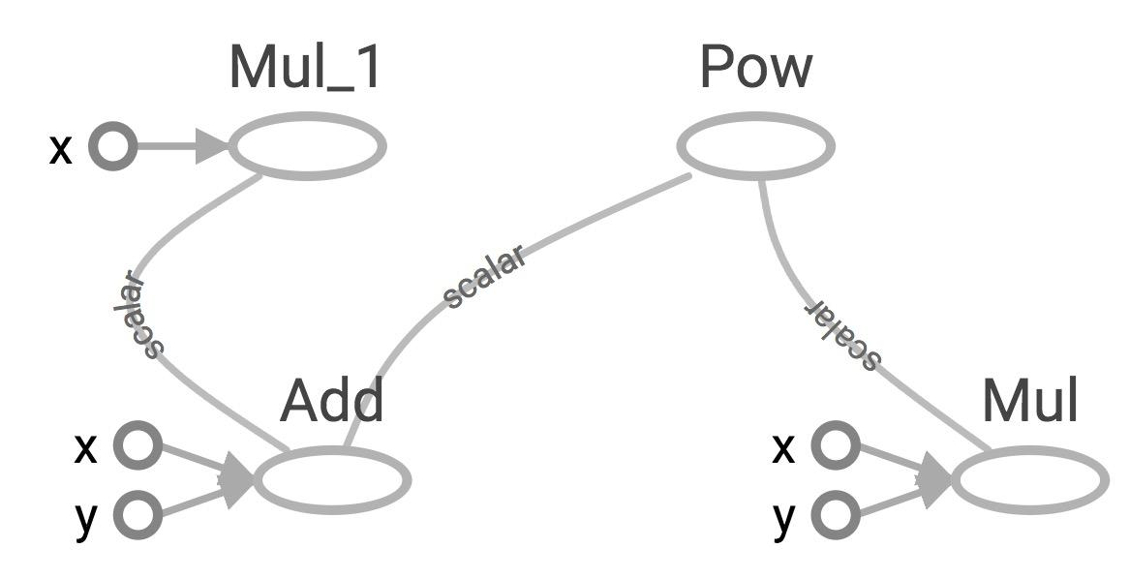
Subgraphs
x = 2 y = 3 add_op = tf.add(x, y) mul_op = tf.multiply(x, y) useless = tf.multiply(x, add_op) pow_op = tf.pow(add_op, mul_op) with tf.Session() as sess: z = sess.run(pow_op)
useless
pow_op
add_op
mul_op
Because we only want the value of pow_op and pow_op doesn’t depend on useless, session won’t compute value of useless
→ save computation

Slide 25
Subgraphs
x = 2 y = 3 add_op = tf.add(x, y) mul_op = tf.multiply(x, y) useless = tf.multiply(x, add_op) pow_op = tf.pow(add_op, mul_op) with tf.Session() as sess: z, not_useless = sess.run([pow_op, useless])
useless
pow_op
add_op
mul_op
tf.Session.run(fetches,
feed_dict=None,
options=None,
run_metadata=None)
fetches is a list of tensors whose values you want

Slide 26
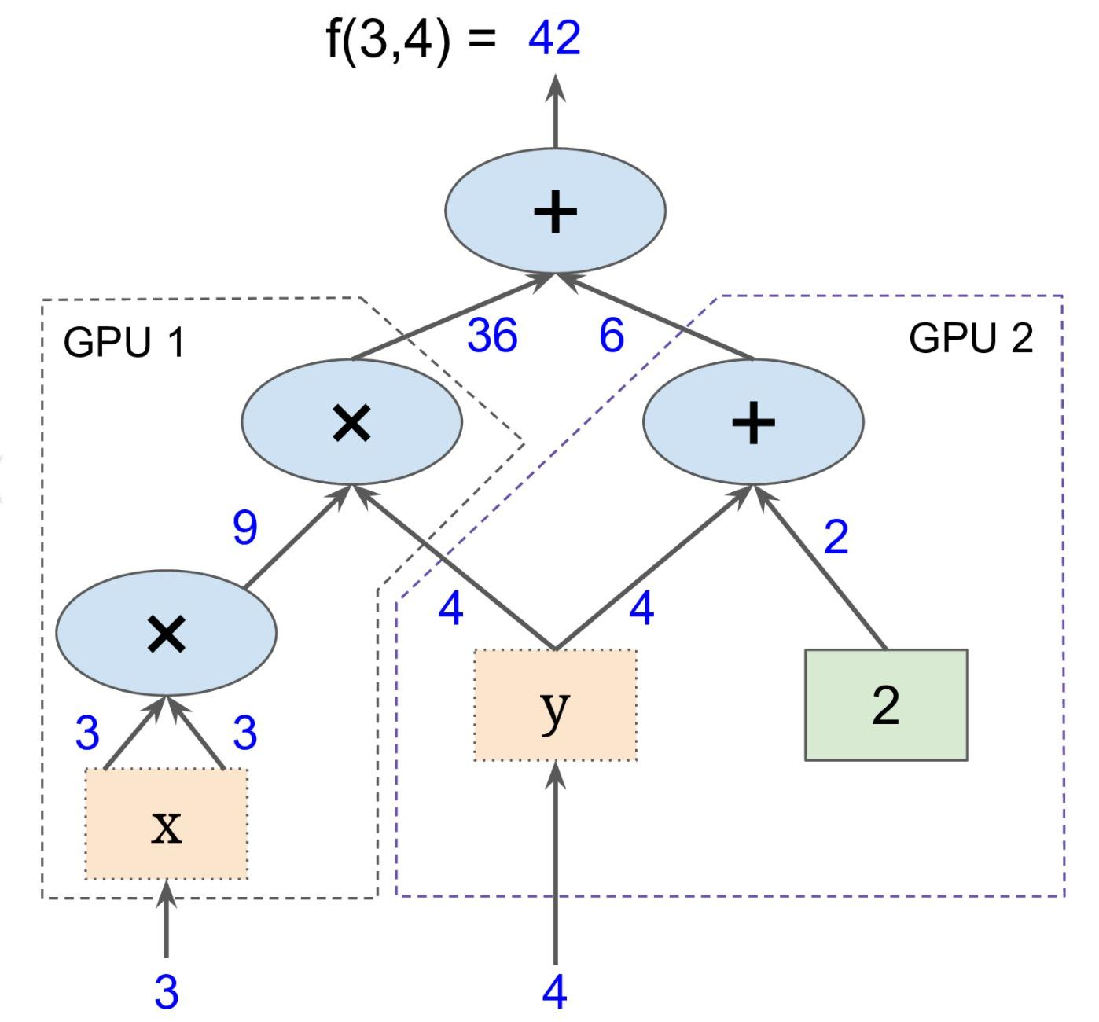
Subgraphs
Possible to break graphs into several chunks and run them parallelly across multiple CPUs, GPUs, TPUs, or other devices
Example: AlexNet
Graph from Hands-On Machine Learning with Scikit-Learn and TensorFlow
Notes:
Example: In the first convolutional layer, AlexNet has 96 filters on two different GPUs. AlexNet is the winner of ImageNet challenge 2012

Slide 27
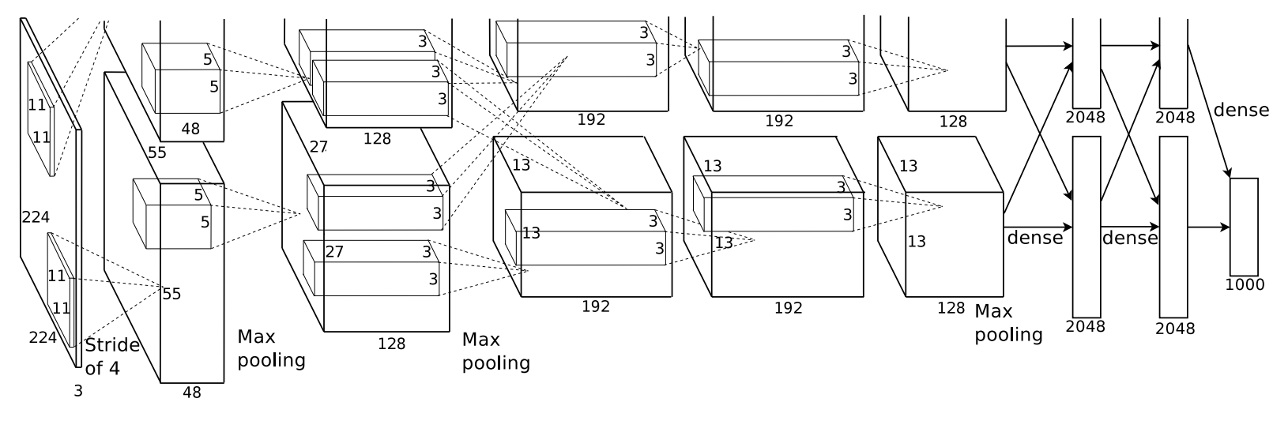
Subgraphs
Example: AlexNet
Notes:
Example: In the first convolutional layer, AlexNet has 96 filters on two different GPUs. AlexNet is the winner of ImageNet challenge 2012

Slide 28
Distributed Computation
To put part of a graph on a specific CPU or GPU:
# Creates a graph.
with tf.device('/gpu:2'):
a = tf.constant([1.0, 2.0, 3.0, 4.0, 5.0, 6.0], name='a')
b = tf.constant([1.0, 2.0, 3.0, 4.0, 5.0, 6.0], name='b')
c = tf.multiply(a, b)
# Creates a session with log_device_placement set to True.
sess = tf.Session(config=tf.ConfigProto(log_device_placement=True))
# Runs the op.
print(sess.run(c))

Slide 29
What if I want to build more
than one graph?

Slide 30
You can
but you don’t need more than one graph
The session runs the default graph

Slide 31
But what if I really want to?

Slide 32
URGH, NO

Slide 33
BUG ALERT!
Multiple graphs require multiple sessions, each will try to use all available resources by default
Can't pass data between them without passing them through python/numpy, which doesn't work in distributed
It’s better to have disconnected subgraphs within one graph

Slide 34
I insist ...

Slide 35
tf.Graph()
create a graph:
g = tf.Graph()

Slide 36
tf.Graph()
to add operators to a graph, set it as default:
g = tf.Graph() with g.as_default(): x = tf.add(3, 5) sess = tf.Session(graph=g) with tf.Session() as sess: sess.run(x)

Slide 37
tf.Graph()
To handle the default graph:
g = tf.get_default_graph()

Slide 38
tf.Graph()
Do not mix default graph and user created graphs
g = tf.Graph()
# add ops to the default graph a = tf.constant(3)
# add ops to the user created graph with g.as_default(): b = tf.constant(5)
Prone to errors

Slide 39
tf.Graph()
Do not mix default graph and user created graphs
g1 = tf.get_default_graph() g2 = tf.Graph()
# add ops to the default graph with g1.as_default(): a = tf.Constant(3)
# add ops to the user created graph with g2.as_default(): b = tf.Constant(5)
Better
But still not good enough because no more than one graph!

Slide 40

Notes:
Why graphs?

Slide 41
Why graphs
Save computation. Only run subgraphs that lead to the values you want to fetch.

Slide 42
Why graphs
Save computation. Only run subgraphs that lead to the values you want to fetch.
Break computation into small, differential pieces to facilitate auto-differentiation

Slide 43
Why graphs
Save computation. Only run subgraphs that lead to the values you want to fetch.
Break computation into small, differential pieces to facilitate auto-differentiation
Facilitate distributed computation, spread the work across multiple CPUs, GPUs, TPUs, or other devices

Slide 44
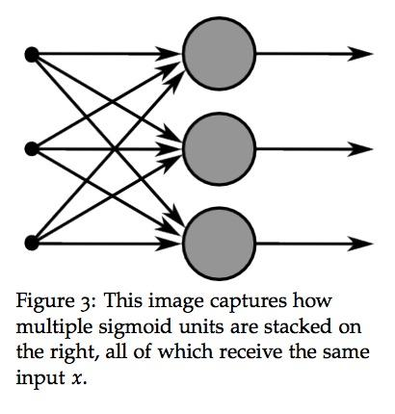
Why graphs
Save computation. Only run subgraphs that lead to the values you want to fetch.
Break computation into small, differential pieces to facilitate auto-differentiation
Facilitate distributed computation, spread the work across multiple CPUs, GPUs, TPUs, or other devices
Many common machine learning models are taught and visualized as directed graphs
A neural net graph from Stanford’s CS224N course
Notes:
Many common machine learning models, such as neural networks, are commonly taught and visualized as directed graphs already, which makes their implementation more natural for machine learning practitioners.
By splitting up computation into small, easily differentiable pieces, TF is able to automatically compute the derivative of any node (or “Operation”, as they’re called in TensorFlow) with respect to any other node that can affect the first node’s output. Being able to compute the derivative/gradient of nodes, especially output nodes, is crucial for setting up machine learning models.
Third having the computation separated, it makes it much easier to distribute work across multiple CPUs, GPUs, and other computational devices. Simply split the whole, larger graph into several smaller graphs and give each device a separate part of the graph to work on (with a touch of logic to coordinate sharing information across devices)

Slide 45
TensorFlow Ops
CS 20: TensorFlow for Deep Learning Research
Lecture 2
1/17/2017

Slide 46
Agenda
Basic operations
Tensor types
Importing data
Lazy loading
Fun with TensorBoard!!!

Slide 47
Your first TensorFlow program
import tensorflow as tf
a = tf.constant(2) b = tf.constant(3) x = tf.add(a, b)
with tf.Session() as sess: print(sess.run(x))
Notes:
Style choice:
sess = tf.Session() instead of with tf.Session()

Slide 48
Your first TensorFlow program
import tensorflow as tf
a = tf.constant(2) b = tf.constant(3) x = tf.add(a, b)
with tf.Session() as sess: print(sess.run(x))
Warning?
The TensorFlow library wasn't compiled to use SSE4.1 instructions, but these are available on your machine and could speed up CPU computations.
Notes:
Style choice:
sess = tf.Session() instead of with tf.Session()

Slide 49
Your first TensorFlow program
import os os.environ['TF_CPP_MIN_LOG_LEVEL']='2' import tensorflow as tf a = tf.constant(2) b = tf.constant(3) x = tf.add(a, b)
with tf.Session() as sess: print(sess.run(x))
No more warning
Notes:
Style choice:
sess = tf.Session() instead of with tf.Session()

Slide 50
Visualize it with TensorBoard
import tensorflow as tf
a = tf.constant(2) b = tf.constant(3) x = tf.add(a, b)
writer = tf.summary.FileWriter('./graphs', tf.get_default_graph()) with tf.Session() as sess: # writer = tf.summary.FileWriter('./graphs', sess.graph) print(sess.run(x)) writer.close() # close the writer when you’re done using it
Create the summary writer after graph definition and before running your session
‘graphs’ or any location where you want to keep your event files
Notes:
You can choose where to put your files. I find it easier

Slide 51
Run it
Go to terminal, run:
$ python3 [yourprogram].py $ tensorboard --logdir="./graphs" --port 6006
Then open your browser and go to: http://localhost:6006/
6006 or any port you want

Slide 52
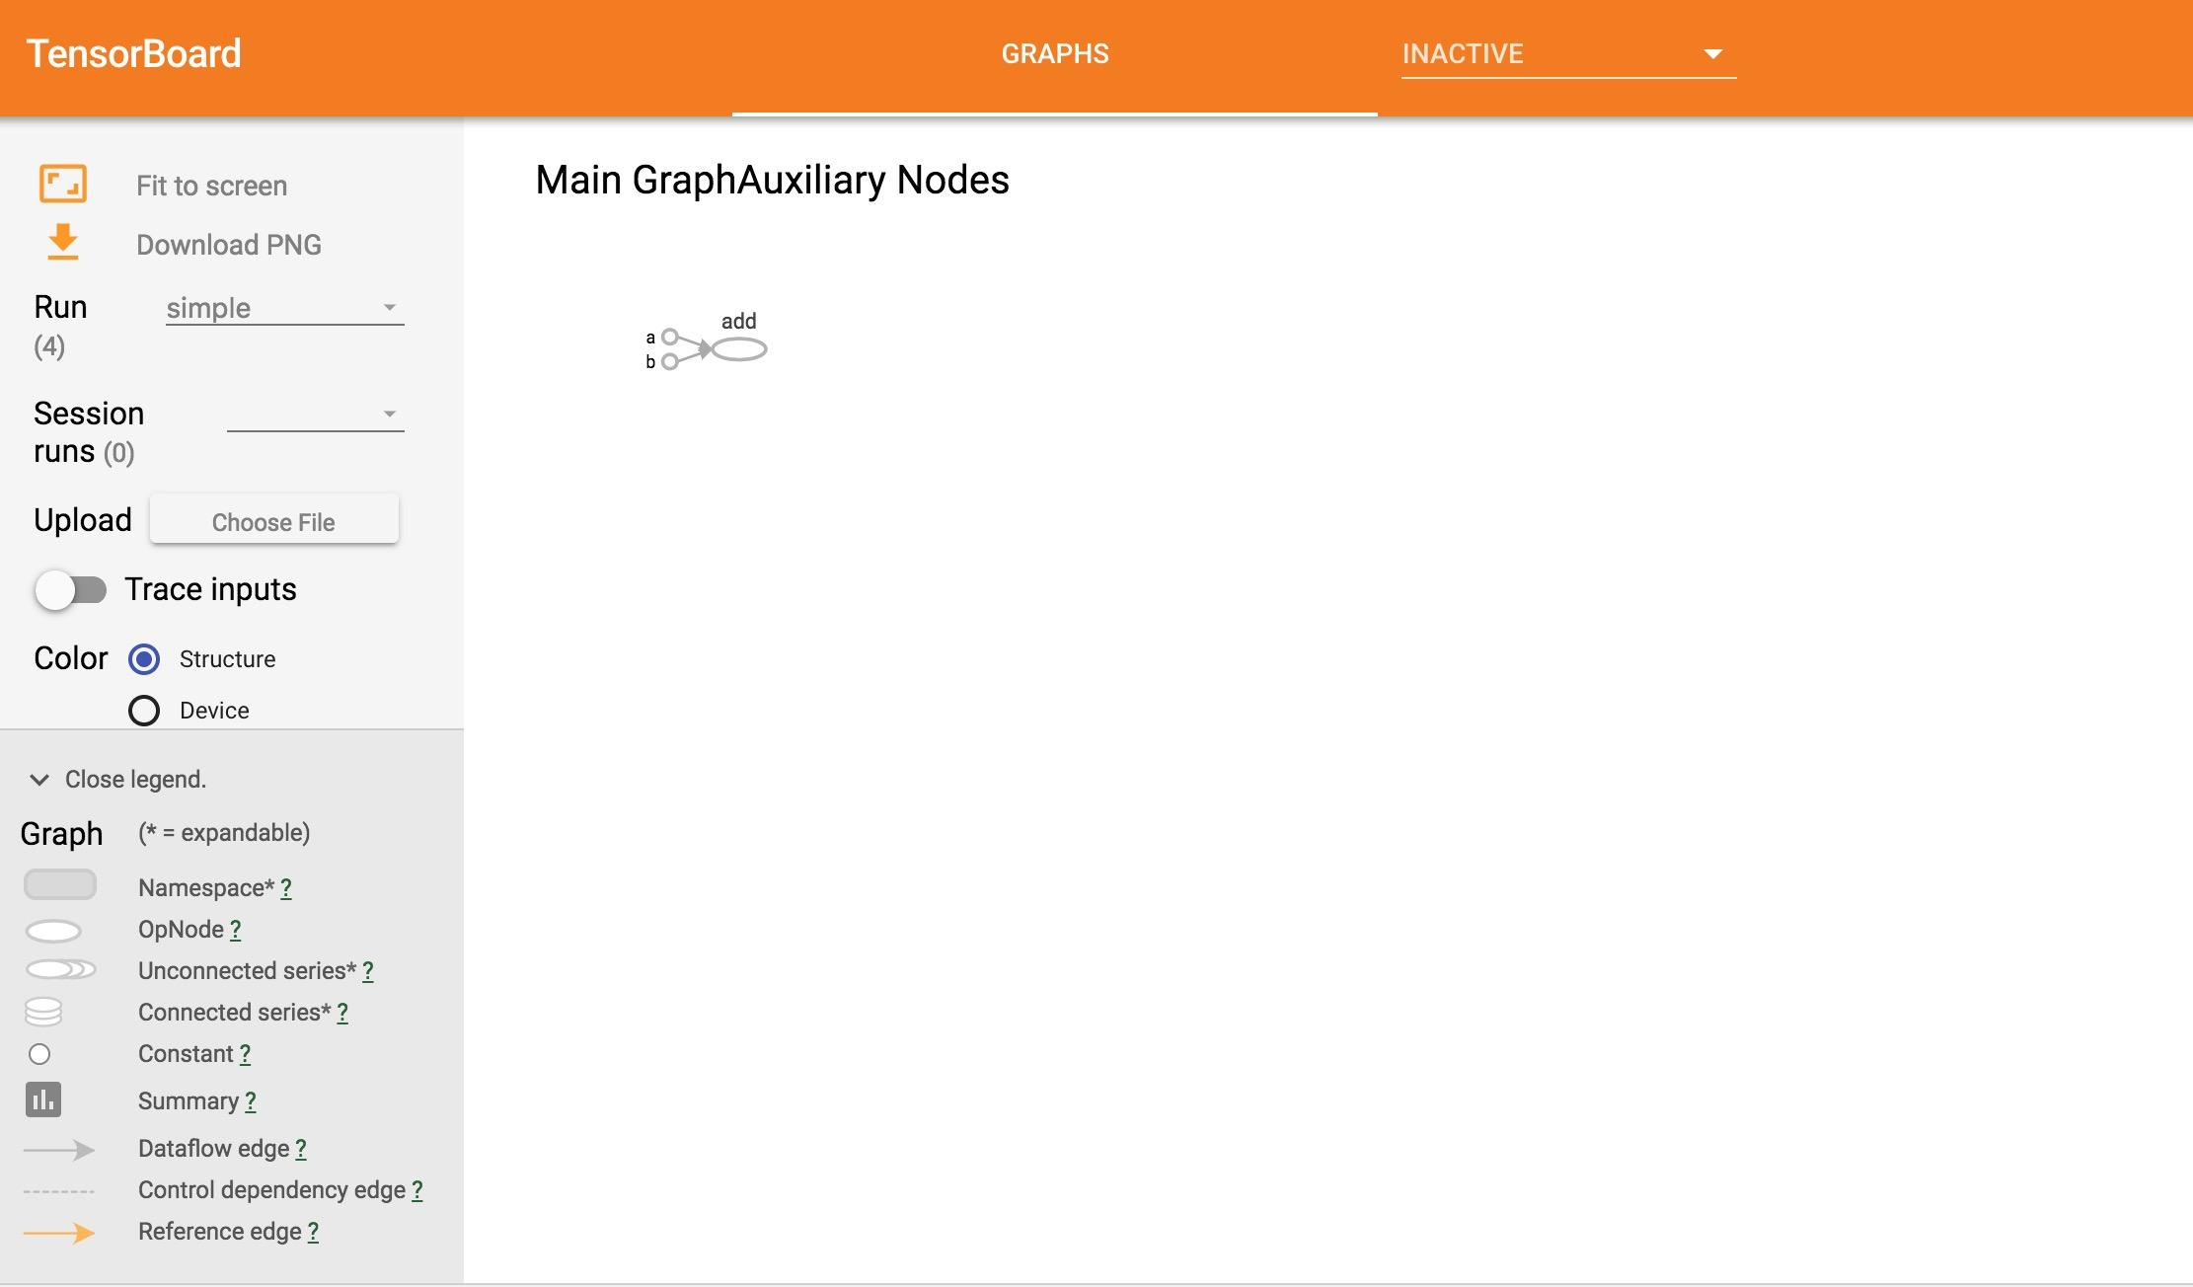
Notes:
let students look at the written graph def first (its a protobuf). show them that the values of `tf.constant()` nodes are stored in the graph def. that's why you only use constant nodes for small values (and variables or readers for larger ones)

Slide 53
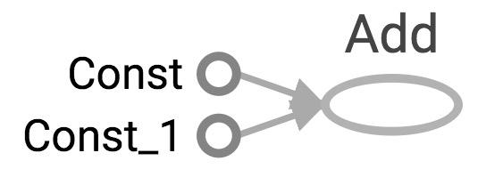
Visualize it with TensorBoard
import tensorflow as tf
a = tf.constant(2) b = tf.constant(3) x = tf.add(a, b) writer = tf.summary.FileWriter('./graphs', tf.get_default_graph()) writer.close()

Slide 54
Visualize it with TensorBoard
import tensorflow as tf
a = tf.constant(2) b = tf.constant(3) x = tf.add(a, b) writer = tf.summary.FileWriter('./graphs', tf.get_default_graph()) writer.close()
Question:
How to change Const, Const_1 to the names we give the variables?

Slide 55
Explicitly name them
import tensorflow as tf
a = tf.constant(2, name='a') b = tf.constant(3, name='b') x = tf.add(a, b, name='add')
writer = tf.summary.FileWriter('./graphs', tf.get_default_graph()) with tf.Session() as sess: print(sess.run(x)) # >> 5

Slide 56
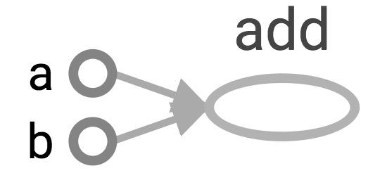
Explicitly name them
import tensorflow as tf
a = tf.constant(2, name='a') b = tf.constant(3, name='b') x = tf.add(a, b, name='add')
writer = tf.summary.FileWriter('./graphs', tf.get_default_graph()) with tf.Session() as sess: print(sess.run(x)) # >> 5

Slide 57
TensorBoard can do much more than just visualizing your graphs.
Learn to use TensorBoard
well and often!

Slide 58
Constants, Sequences, Variables, Ops

Slide 59
Constants
import tensorflow as tf
a = tf.constant([2, 2], name='a') b = tf.constant([[0, 1], [2, 3]], name='b')
tf.constant(
value,
dtype=None,
shape=None,
name='Const',
verify_shape=False
)

Slide 60
Constants
import tensorflow as tf
a = tf.constant([2, 2], name='a') b = tf.constant([[0, 1], [2, 3]], name='b') x = tf.multiply(a, b, name='mul')
with tf.Session() as sess: print(sess.run(x))
# >> [[0 2] # [4 6]]
Broadcasting similar to NumPy

Slide 61
Tensors filled with a specific value
tf.zeros(shape, dtype=tf.float32, name=None)
creates a tensor of shape and all elements will be zeros
tf.zeros([2, 3], tf.int32) ==> [[0, 0, 0], [0, 0, 0]]
Similar to numpy.zeros
Notes:
These are more compact than constants in the graph def, resulting in faster startup (especially in distributed where the graph must be send to all workers)

Slide 62
Tensors filled with a specific value
tf.zeros_like(input_tensor, dtype=None, name=None, optimize=True)
creates a tensor of shape and type (unless type is specified) as the input_tensor but all elements are zeros.
# input_tensor is [[0, 1], [2, 3], [4, 5]]
tf.zeros_like(input_tensor) ==> [[0, 0], [0, 0], [0, 0]]
Similar to numpy.zeros_like

Slide 63
Tensors filled with a specific value
tf.ones(shape, dtype=tf.float32, name=None)
tf.ones_like(input_tensor, dtype=None, name=None, optimize=True)
Similar to numpy.ones, numpy.ones_like

Slide 64
Tensors filled with a specific value
tf.fill(dims, value, name=None)
creates a tensor filled with a scalar value.
tf.fill([2, 3], 8) ==> [[8, 8, 8], [8, 8, 8]]
Similar to NumPy.full

Slide 65
Constants as sequences
tf.lin_space(start, stop, num, name=None) tf.lin_space(10.0, 13.0, 4) ==> [10. 11. 12. 13.]
tf.range(start, limit=None, delta=1, dtype=None, name='range') tf.range(3, 18, 3) ==> [3 6 9 12 15] tf.range(5) ==> [0 1 2 3 4]
NOT THE SAME AS NUMPY SEQUENCES
Tensor objects are not iterable
for _ in tf.range(4): # TypeError
Notes:
# create a sequence of num evenly-spaced values are generated beginning at start. If num > 1, the values in the sequence increase by stop - start / num - 1, so that the last one is exactly stop.
create a sequence of numbers that begins at start and extends by increments of delta up to but not including limit

Slide 66
Randomly Generated Constants
tf.random_normal
tf.truncated_normal
tf.random_uniform
tf.random_shuffle
tf.random_crop
tf.multinomial
tf.random_gamma
Notes:
You’ll often see use of tf.truncated_normal() instead of tf.random_normal(), as it doesn’t create any values more than two standard deviations away from its mean.

Slide 67
Randomly Generated Constants
tf.set_random_seed(seed)

Slide 68
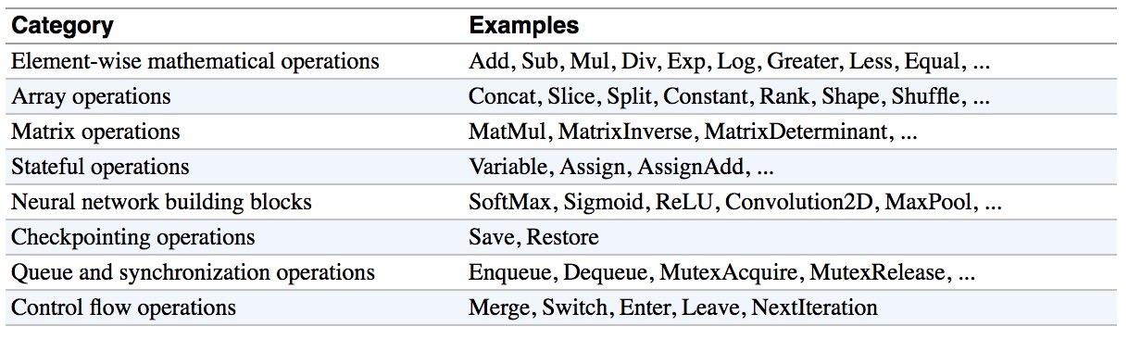
Operations
Buduma. Fundamentals of Deep Learning. O’Reilly, 2017
Notes:
Should i keep this or nah?
Not sure it adds much that isn’t already in the slides -straka

Slide 69
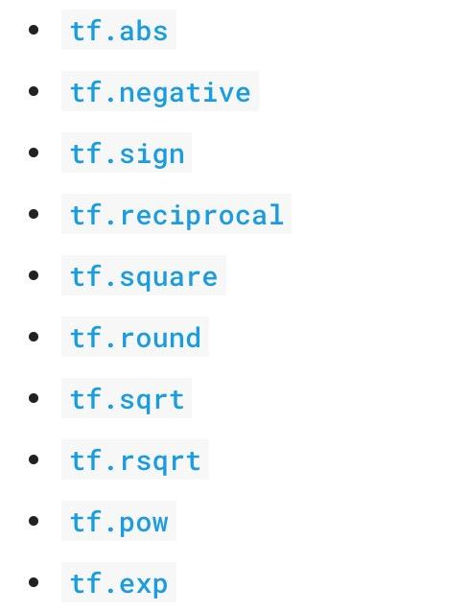
Arithmetic Ops
Pretty standard, quite similar to numpy.

Slide 70
Wizard of Div
a = tf.constant([2, 2], name='a')
b = tf.constant([[0, 1], [2, 3]], name='b')
with tf.Session() as sess:
print(sess.run(tf.div(b, a))) ⇒ [[0 0] [1 1]]
print(sess.run(tf.divide(b, a))) ⇒ [[0. 0.5] [1. 1.5]]
print(sess.run(tf.truediv(b, a))) ⇒ [[0. 0.5] [1. 1.5]]
print(sess.run(tf.floordiv(b, a))) ⇒ [[0 0] [1 1]]
print(sess.run(tf.realdiv(b, a))) ⇒ # Error: only works for real values
print(sess.run(tf.truncatediv(b, a))) ⇒ [[0 0] [1 1]]
print(sess.run(tf.floor_div(b, a))) ⇒ [[0 0] [1 1]]
Notes:
Make sure you read the documentation to understand which one to use. High level,, tf.div does TensorFlow’s style division, while tf.divide does exactly Python’s style division.

Slide 71
TensorFlow Data Types
TensorFlow takes Python natives types: boolean, numeric (int, float), strings
t_0 = 19 # scalars are treated like 0-d tensors
tf.zeros_like(t_0) # ==> 0
tf.ones_like(t_0) # ==> 1
Notes:
Single values will be converted to 0-d tensors (or scalars), lists of values will be converted to 1-d tensors (vectors), lists of lists of values will be converted to 2-d
tensors (matrices), and so on.

Slide 72
TensorFlow Data Types
TensorFlow takes Python natives types: boolean, numeric (int, float), strings
t_0 = 19 # scalars are treated like 0-d tensors
tf.zeros_like(t_0) # ==> 0
tf.ones_like(t_0) # ==> 1
t_1 = [b"apple", b"peach", b"grape"] # 1-d arrays are treated like 1-d tensors
tf.zeros_like(t_1) # ==> ?????
Notes:
Single values will be converted to 0-d tensors (or scalars), lists of values will be converted to 1-d tensors (vectors), lists of lists of values will be converted to 2-d
tensors (matrices), and so on.

Slide 73
TensorFlow Data Types
TensorFlow takes Python natives types: boolean, numeric (int, float), strings
t_0 = 19 # scalars are treated like 0-d tensors
tf.zeros_like(t_0) # ==> 0
tf.ones_like(t_0) # ==> 1
t_1 = [b"apple", b"peach", b"grape"] # 1-d arrays are treated like 1-d tensors
tf.zeros_like(t_1) # ==> [b'' b'' b'']
Notes:
Single values will be converted to 0-d tensors (or scalars), lists of values will be converted to 1-d tensors (vectors), lists of lists of values will be converted to 2-d
tensors (matrices), and so on.

Slide 74
TensorFlow Data Types
TensorFlow takes Python natives types: boolean, numeric (int, float), strings
t_0 = 19 # scalars are treated like 0-d tensors
tf.zeros_like(t_0) # ==> 0
tf.ones_like(t_0) # ==> 1
t_1 = [b"apple", b"peach", b"grape"] # 1-d arrays are treated like 1-d tensors
tf.zeros_like(t_1) # ==> [b'' b'' b'']
tf.ones_like(t_1) # ==> ?????
Notes:
Single values will be converted to 0-d tensors (or scalars), lists of values will be converted to 1-d tensors (vectors), lists of lists of values will be converted to 2-d
tensors (matrices), and so on.

Slide 75
TensorFlow Data Types
TensorFlow takes Python natives types: boolean, numeric (int, float), strings
t_0 = 19 # scalars are treated like 0-d tensors
tf.zeros_like(t_0) # ==> 0
tf.ones_like(t_0) # ==> 1
t_1 = [b"apple", b"peach", b"grape"] # 1-d arrays are treated like 1-d tensors
tf.zeros_like(t_1) # ==> [b'' b'' b'']
tf.ones_like(t_1) # ==> TypeError: Expected string, got 1 of type 'int' instead.
Notes:
Single values will be converted to 0-d tensors (or scalars), lists of values will be converted to 1-d tensors (vectors), lists of lists of values will be converted to 2-d
tensors (matrices), and so on.

Slide 76
TensorFlow Data Types
TensorFlow takes Python natives types: boolean, numeric (int, float), strings
t_0 = 19 # scalars are treated like 0-d tensors
tf.zeros_like(t_0) # ==> 0
tf.ones_like(t_0) # ==> 1
t_1 = [b"apple", b"peach", b"grape"] # 1-d arrays are treated like 1-d tensors
tf.zeros_like(t_1) # ==> [b'' b'' b'']
tf.ones_like(t_1) # ==> TypeError: Expected string, got 1 of type 'int' instead.
t_2 = [[True, False, False],
[False, False, True],
[False, True, False]] # 2-d arrays are treated like 2-d tensors
tf.zeros_like(t_2) # ==> ?????
tf.ones_like(t_2) # ==> ?????
Notes:
Single values will be converted to 0-d tensors (or scalars), lists of values will be converted to 1-d tensors (vectors), lists of lists of values will be converted to 2-d
tensors (matrices), and so on.

Slide 77
TensorFlow Data Types
TensorFlow takes Python natives types: boolean, numeric (int, float), strings
t_0 = 19 # scalars are treated like 0-d tensors
tf.zeros_like(t_0) # ==> 0
tf.ones_like(t_0) # ==> 1
t_1 = [b"apple", b"peach", b"grape"] # 1-d arrays are treated like 1-d tensors
tf.zeros_like(t_1) # ==> [b'' b'' b'']
tf.ones_like(t_1) # ==> TypeError: Expected string, got 1 of type 'int' instead.
t_2 = [[True, False, False],
[False, False, True],
[False, True, False]] # 2-d arrays are treated like 2-d tensors
tf.zeros_like(t_2) # ==> 3x3 tensor, all elements are False
tf.ones_like(t_2) # ==> 3x3 tensor, all elements are True
Notes:
Single values will be converted to 0-d tensors (or scalars), lists of values will be converted to 1-d tensors (vectors), lists of lists of values will be converted to 2-d
tensors (matrices), and so on.

Slide 78
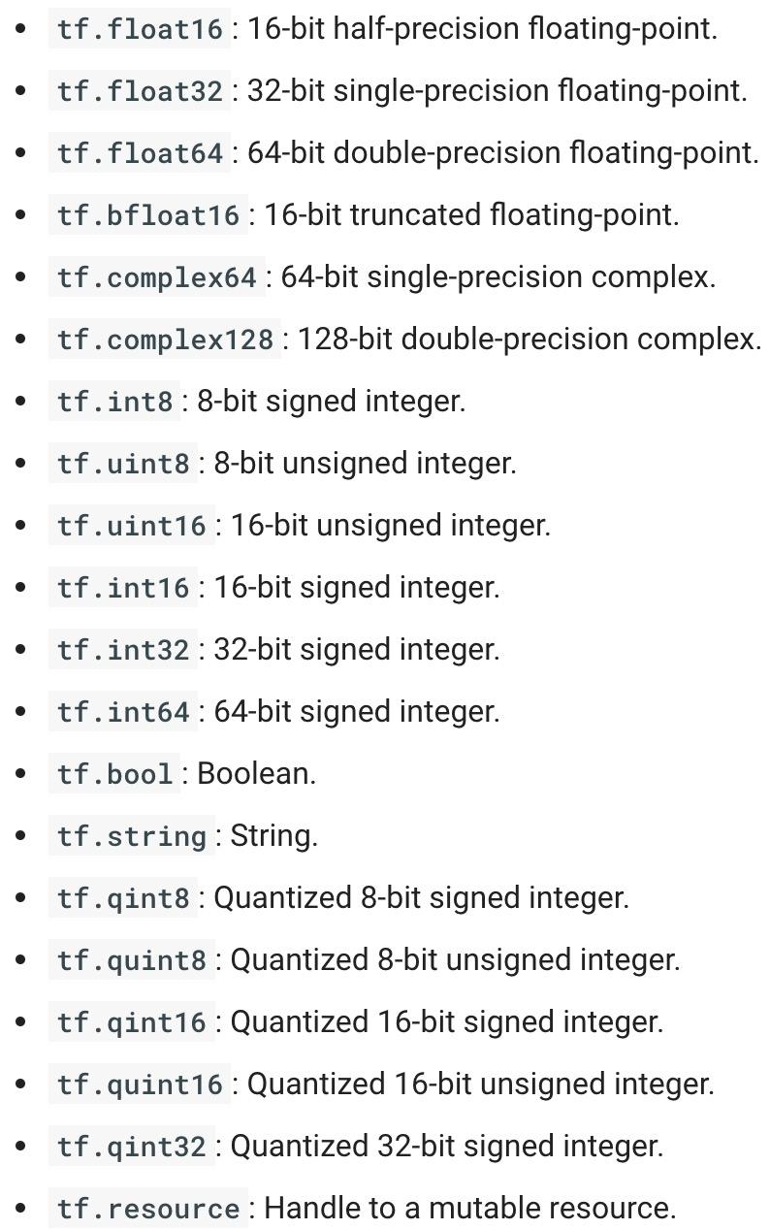
TensorFlow Data Types
Notes:
https://www.tensorflow.org/api_docs/python/tf/DType

Slide 79
TF vs NP Data Types
TensorFlow integrates seamlessly with NumPy
tf.int32 == np.int32 # ⇒ True
Can pass numpy types to TensorFlow ops
tf.ones([2, 2], np.float32) # ⇒ [[1.0 1.0], [1.0 1.0]]
For tf.Session.run(fetches): if the requested fetch is a Tensor , output will be a NumPy ndarray.
sess = tf.Session()
a = tf.zeros([2, 3], np.int32)
print(type(a)) # ⇒ <class 'tensorflow.python.framework.ops.Tensor'>
a = sess.run(a)
print(type(a)) # ⇒ <class 'numpy.ndarray'>

Slide 80
TF vs NP Data Types
TensorFlow integrates seamlessly with NumPy
tf.int32 == np.int32 # ⇒ True
Can pass numpy types to TensorFlow ops
tf.ones([2, 2], np.float32) # ⇒ [[1.0 1.0], [1.0 1.0]]
For tf.Session.run(fetches): if the requested fetch is a Tensor , output will be a NumPy ndarray.
sess = tf.Session()
a = tf.zeros([2, 3], np.int32)
print(type(a))
a = sess.run(a) <<<< Avoid doing this. Use a_out = sess.run(a)
print(type(a))

Slide 81
Use TF DType when possible
Python native types: TensorFlow has to infer Python type
Notes:
Using Python types to specify TensorFlow objects is quick and easy, and it is useful for prototyping ideas. However, there is an important pitfall in doing it this way. Python types lack the ability to explicitly state the data type, but TensorFlow’s data types are more specific. For example, all integers are the same type, but TensorFlow has 8-bit, 16-bit, 32-bit, and 64-bit integers available. Therefore, if you use a Python type, TensorFlow has to infer which data type you mean.
It’s possible to convert the data into the appropriate type when you pass it into TensorFlow, but certain data types still may be difficult to declare correctly, such as complex numbers. Because of this, it is recommended to created hand-defined Tensor objects as NumPy arrays.

Slide 82
Use TF DType when possible
Python native types: TensorFlow has to infer Python type
NumPy arrays: NumPy is not GPU compatible
Notes:
It’s possible to convert the data into the appropriate type when you pass it into TensorFlow, but certain data types still may be difficult to declare correctly, such as complex numbers. Because of this, it is recommended to created hand-defined Tensor objects as NumPy arrays.

Slide 83
What’s wrong with constants ...
… other than being constant?

Slide 84
What’s wrong with constants?
Constants are stored in the graph definition

Slide 85
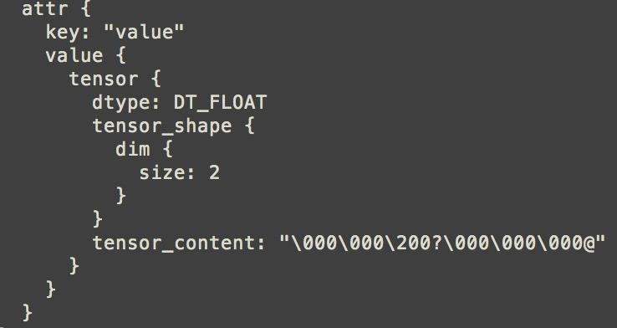
Print out the graph def
my_const = tf.constant([1.0, 2.0], name="my_const")
with tf.Session() as sess: print(sess.graph.as_graph_def())
Notes:
The graph definition is stored in a protobuf (protocol buffers, Google's language-neutral, platform-neutral, extensible mechanism for serializing structured data – think XML, but smaller, faster, and simpler.)

Slide 86
What’s wrong with constants?
This makes loading graphs expensive when constants are big

Slide 87
What’s wrong with constants?
This makes loading graphs expensive when constants are big
Only use constants for primitive types.
Use variables or readers for more data that requires more memory

Slide 88
Variables
# create variables with tf.Variable
s = tf.Variable(2, name="scalar")
m = tf.Variable([[0, 1], [2, 3]], name="matrix")
W = tf.Variable(tf.zeros([784,10]))

Slide 89
Variables
# create variables with tf.Variable
s = tf.Variable(2, name="scalar")
m = tf.Variable([[0, 1], [2, 3]], name="matrix")
W = tf.Variable(tf.zeros([784,10]))
# create variables with tf.get_variable
s = tf.get_variable("scalar", initializer=tf.constant(2))
m = tf.get_variable("matrix", initializer=tf.constant([[0, 1], [2, 3]]))
W = tf.get_variable("big_matrix", shape=(784, 10), initializer=tf.zeros_initializer())

Slide 90


Variables
# create variables with tf.Variable
s = tf.Variable(2, name="scalar")
m = tf.Variable([[0, 1], [2, 3]], name="matrix")
W = tf.Variable(tf.zeros([784,10]))
# create variables with tf.get_variable
s = tf.get_variable("scalar", initializer=tf.constant(2))
m = tf.get_variable("matrix", initializer=tf.constant([[0, 1], [2, 3]]))
W = tf.get_variable("big_matrix", shape=(784, 10), initializer=tf.zeros_initializer())

Slide 91
Variables
# create variables with tf.Variable
s = tf.Variable(2, name="scalar")
m = tf.Variable([[0, 1], [2, 3]], name="matrix")
W = tf.Variable(tf.zeros([784,10]))
# create variables with tf.get_variable
s = tf.get_variable("scalar", initializer=tf.constant(2))
m = tf.get_variable("matrix", initializer=tf.constant([[0, 1], [2, 3]]))
W = tf.get_variable("big_matrix", shape=(784, 10), initializer=tf.zeros_initializer())
Why tf.constant but tf.Variable?

Slide 92
Variables
# create variables with tf.Variable
s = tf.Variable(2, name="scalar")
m = tf.Variable([[0, 1], [2, 3]], name="matrix")
W = tf.Variable(tf.zeros([784,10]))
# create variables with tf.get_variable
s = tf.get_variable("scalar", initializer=tf.constant(2))
m = tf.get_variable("matrix", initializer=tf.constant([[0, 1], [2, 3]]))
W = tf.get_variable("big_matrix", shape=(784, 10), initializer=tf.zeros_initializer())
tf.constant is an op
tf.Variable is a class with many ops

Slide 93
tf.Variable class
# create variables with tf.get_variable
s = tf.get_variable("scalar", initializer=tf.constant(2))
m = tf.get_variable("matrix", initializer=tf.constant([[0, 1], [2, 3]]))
W = tf.get_variable("big_matrix", shape=(784, 10), initializer=tf.zeros_initializer())
tf.Variable holds several ops:
x = tf.Variable(...)
x.initializer # init op
x.value() # read op
x.assign(...) # write op
x.assign_add(...) # and more
Notes:
As a shortcut, TF allows you to omit the `.value` in many cases, so you can pass values of vars to other ops as tf.add(x, ...) rather than tf.add(x.value, ...).

Slide 94
tf.Variable class
# create variables with tf.get_variable
s = tf.get_variable("scalar", initializer=tf.constant(2))
m = tf.get_variable("matrix", initializer=tf.constant([[0, 1], [2, 3]]))
W = tf.get_variable("big_matrix", shape=(784, 10), initializer=tf.zeros_initializer())
with tf.Session() as sess: print(sess.run(W)) >> FailedPreconditionError: Attempting to use uninitialized value Variable

Slide 95
You have to initialize your variables
The easiest way is initializing all variables at once:
with tf.Session() as sess:
sess.run(tf.global_variables_initializer())
Initializer is an op. You need to execute it within the context of a session

Slide 96
You have to initialize your variables
The easiest way is initializing all variables at once:
with tf.Session() as sess:
sess.run(tf.global_variables_initializer())
Initialize only a subset of variables:
with tf.Session() as sess:
sess.run(tf.variables_initializer([a, b]))

Slide 97
You have to initialize your variables
The easiest way is initializing all variables at once:
with tf.Session() as sess:
sess.run(tf.global_variables_initializer())
Initialize only a subset of variables:
with tf.Session() as sess:
sess.run(tf.variables_initializer([a, b]))
Initialize a single variable
W = tf.Variable(tf.zeros([784,10]))
with tf.Session() as sess:
sess.run(W.initializer)

Slide 98
Eval() a variable
# W is a random 700 x 100 variable object
W = tf.Variable(tf.truncated_normal([700, 10]))
with tf.Session() as sess:
sess.run(W.initializer)
print(W)
>> Tensor("Variable/read:0", shape=(700, 10), dtype=float32)

Slide 99
Eval() a variable
# W is a random 700 x 100 variable object
W = tf.Variable(tf.truncated_normal([700, 10]))
with tf.Session() as sess:
sess.run(W.initializer)
print(W.eval()) # Similar to print(sess.run(W))
>> [[-0.76781619 -0.67020458 1.15333688 ..., -0.98434633 -1.25692499
-0.90904623]
[-0.36763489 -0.65037876 -1.52936983 ..., 0.19320194 -0.38379928
0.44387451]
[ 0.12510735 -0.82649058 0.4321366 ..., -0.3816964 0.70466036
1.33211911]
...,
[ 0.9203397 -0.99590844 0.76853162 ..., -0.74290705 0.37568584
0.64072722]
[-0.12753558 0.52571583 1.03265858 ..., 0.59978199 -0.91293705
-0.02646019]
[ 0.19076447 -0.62968266 -1.97970271 ..., -1.48389161 0.68170643
1.46369624]]
Notes:
You have to

Slide 100
tf.Variable.assign()
W = tf.Variable(10)
W.assign(100)
with tf.Session() as sess:
sess.run(W.initializer)
print(W.eval()) # >> ????

Slide 101
tf.Variable.assign()
W = tf.Variable(10)
W.assign(100)
with tf.Session() as sess:
sess.run(W.initializer)
print(W.eval()) # >> 10
Ugh, why?

Slide 102
tf.Variable.assign()
W = tf.Variable(10)
W.assign(100)
with tf.Session() as sess:
sess.run(W.initializer)
print(W.eval()) # >> 10
W.assign(100) creates an assign op.
That op needs to be executed in a session to take effect.

Slide 103
tf.Variable.assign()
W = tf.Variable(10)
W.assign(100)
with tf.Session() as sess:
sess.run(W.initializer)
print(W.eval()) # >> 10
--------
W = tf.Variable(10)
assign_op = W.assign(100)
with tf.Session() as sess:
sess.run(W.initializer)
sess.run(assign_op)
print(W.eval()) # >> 100
Notes:
You don’t need to initialize variable because assign_op does it for you. In fact, initializer op is the assign op that assigns the variable’s initial value to the variable itself.

Slide 104
tf.Variable.assign()
# create a variable whose original value is 2
my_var = tf.Variable(2, name="my_var")
# assign a * 2 to a and call that op a_times_two
my_var_times_two = my_var.assign(2 * my_var)
with tf.Session() as sess:
sess.run(my_var.initializer)
sess.run(my_var_times_two) # >> what’s the value of my_var now?

Slide 105
tf.Variable.assign()
# create a variable whose original value is 2
my_var = tf.Variable(2, name="my_var")
# assign a * 2 to a and call that op a_times_two
my_var_times_two = my_var.assign(2 * my_var)
with tf.Session() as sess:
sess.run(my_var.initializer)
sess.run(my_var_times_two) # >> the value of my_var now is 4
sess.run(my_var_times_two) # >> the value of my_var now is ???

Slide 106
tf.Variable.assign()
# create a variable whose original value is 2
my_var = tf.Variable(2, name="my_var")
# assign a * 2 to a and call that op a_times_two
my_var_times_two = my_var.assign(2 * my_var)
with tf.Session() as sess:
sess.run(my_var.initializer)
sess.run(my_var_times_two) # >> the value of my_var now is 4
sess.run(my_var_times_two) # >> the value of my_var now is 8
sess.run(my_var_times_two) # >> the value of my_var now is 16
It assign 2 * my_var to my_var every time my_var_times_two op is executed.

Slide 107
assign_add() and assign_sub()
my_var = tf.Variable(10)
With tf.Session() as sess: sess.run(my_var.initializer) # increment by 10 sess.run(my_var.assign_add(10)) # >> 20
# decrement by 2 sess.run(my_var.assign_sub(2)) # >> 18
Notes:
assign_add() and assign_sub() can’t initialize the variable my_var for you because these ops need the original value of my_var

Slide 108
Each session maintains its own copy of variables
W = tf.Variable(10)
sess1 = tf.Session()
sess2 = tf.Session()
sess1.run(W.initializer)
sess2.run(W.initializer)
print(sess1.run(W.assign_add(10))) # >> 20
print(sess2.run(W.assign_sub(2))) # >> ?

Slide 109
Each session maintains its own copy of variables
W = tf.Variable(10)
sess1 = tf.Session()
sess2 = tf.Session()
sess1.run(W.initializer)
sess2.run(W.initializer)
print(sess1.run(W.assign_add(10))) # >> 20
print(sess2.run(W.assign_sub(2))) # >> 8

Slide 110
Each session maintains its own copy of variables
W = tf.Variable(10)
sess1 = tf.Session()
sess2 = tf.Session()
sess1.run(W.initializer)
sess2.run(W.initializer)
print(sess1.run(W.assign_add(10))) # >> 20
print(sess2.run(W.assign_sub(2))) # >> 8
print(sess1.run(W.assign_add(100))) # >> 120
print(sess2.run(W.assign_sub(50))) # >> -42
sess1.close()
sess2.close()

Slide 111
Control Dependencies
tf.Graph.control_dependencies(control_inputs)
# defines which ops should be run first
# your graph g have 5 ops: a, b, c, d, e
g = tf.get_default_graph()
with g.control_dependencies([a, b, c]):
# 'd' and 'e' will only run after 'a', 'b', and 'c' have executed.
d = ...
e = …
Notes:
Sometimes, we will have two more two independent ops but you’d like to specify which op should be run first, then you use tf.Graph.control_dependencies(control_inputs)

Slide 112
Getting to know each other?

Slide 113
Placeholder

Slide 114
A quick reminder
A TF program often has 2 phases:
Assemble a graph
Use a session to execute operations in the graph.

Slide 115
Placeholders
A TF program often has 2 phases:
Assemble a graph
Use a session to execute operations in the graph.
⇒ Assemble the graph first without knowing the values needed for computation

Slide 116
Placeholders
A TF program often has 2 phases:
Assemble a graph
Use a session to execute operations in the graph.
⇒ Assemble the graph first without knowing the values needed for computation
Analogy:
Define the function f(x, y) = 2 * x + y without knowing value of x or y.
x, y are placeholders for the actual values.

Slide 117
Why placeholders?
We, or our clients, can later supply their own data when they need to execute the computation.

Slide 118
Placeholders
tf.placeholder(dtype, shape=None, name=None)
# create a placeholder for a vector of 3 elements, type tf.float32
a = tf.placeholder(tf.float32, shape=[3])
b = tf.constant([5, 5, 5], tf.float32)
# use the placeholder as you would a constant or a variable
c = a + b # short for tf.add(a, b)
with tf.Session() as sess:
print(sess.run(c)) # >> ???

Slide 119
Placeholders
tf.placeholder(dtype, shape=None, name=None)
# create a placeholder for a vector of 3 elements, type tf.float32
a = tf.placeholder(tf.float32, shape=[3])
b = tf.constant([5, 5, 5], tf.float32)
# use the placeholder as you would a constant or a variable
c = a + b # short for tf.add(a, b)
with tf.Session() as sess:
print(sess.run(c)) # >> InvalidArgumentError: a doesn’t an actual value

Slide 120
Supplement the values to placeholders using a dictionary

Slide 121
Placeholders
tf.placeholder(dtype, shape=None, name=None)
# create a placeholder for a vector of 3 elements, type tf.float32
a = tf.placeholder(tf.float32, shape=[3])
b = tf.constant([5, 5, 5], tf.float32)
# use the placeholder as you would a constant or a variable
c = a + b # short for tf.add(a, b)
with tf.Session() as sess:
print(sess.run(c, feed_dict={a: [1, 2, 3]})) # the tensor a is the key, not the string ‘a’
# >> [6, 7, 8]

Slide 122
Placeholders
tf.placeholder(dtype, shape=None, name=None)
# create a placeholder for a vector of 3 elements, type tf.float32
a = tf.placeholder(tf.float32, shape=[3])
b = tf.constant([5, 5, 5], tf.float32)
# use the placeholder as you would a constant or a variable
c = a + b # short for tf.add(a, b)
with tf.Session() as sess:
print(sess.run(c, feed_dict={a: [1, 2, 3]}))
# >> [6, 7, 8]
Quirk:
shape=None means that tensor of any shape will be accepted as value for placeholder.
shape=None is easy to construct graphs, but nightmarish for debugging

Slide 123
Placeholders
tf.placeholder(dtype, shape=None, name=None)
# create a placeholder of type float 32-bit, shape is a vector of 3 elements
a = tf.placeholder(tf.float32, shape=[3])
# create a constant of type float 32-bit, shape is a vector of 3 elements
b = tf.constant([5, 5, 5], tf.float32)
# use the placeholder as you would a constant or a variable
c = a + b # Short for tf.add(a, b)
with tf.Session() as sess:
print(sess.run(c, {a: [1, 2, 3]}))
# >> [6, 7, 8]
Quirk:
shape=None also breaks all following shape inference, which makes many ops not work because they expect certain rank.
Notes:
The session will look at the graph, trying to think: hmm, how can I get the value of a, then it computes all the nodes that leads to a.

Slide 124
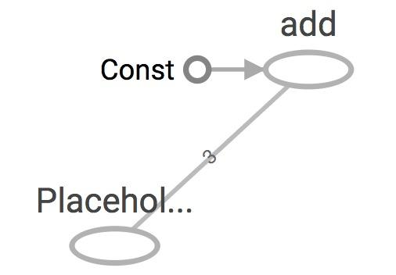
Placeholders are valid ops
tf.placeholder(dtype, shape=None, name=None)
# create a placeholder of type float 32-bit, shape is a vector of 3 elements
a = tf.placeholder(tf.float32, shape=[3])
# create a constant of type float 32-bit, shape is a vector of 3 elements
b = tf.constant([5, 5, 5], tf.float32)
# use the placeholder as you would a constant or a variable
c = a + b # Short for tf.add(a, b)
with tf.Session() as sess:
print(sess.run(c, {a: [1, 2, 3]}))
# >> [6, 7, 8]
Notes:
we can feed_dict any tensors. placeholders are just a way to indicate that sth must be fed

Slide 125
What if want to feed multiple data points in?
You have to do it one at a time
with tf.Session() as sess:
for a_value in list_of_values_for_a:
print(sess.run(c, {a: a_value}))

Slide 126
You can feed_dict any feedable tensor.
Placeholder is just a way to indicate that something must be fed

Slide 127
tf.Graph.is_feedable(tensor)
# True if and only if tensor is feedable.
Notes:
Example from GitHub

Slide 128
Feeding values to TF ops
# create operations, tensors, etc (using the default graph)
a = tf.add(2, 5)
b = tf.multiply(a, 3)
with tf.Session() as sess:
# compute the value of b given a is 15
sess.run(b, feed_dict={a: 15}) # >> 45
Notes:
The session will look at the graph, trying to think: hmm, how can I get the value of a, then it computes all the nodes that leads to a.

Slide 129
Extremely helpful for testing
Feed in dummy values to test parts of a large graph
Notes:
When you have a large graph and just want to test out certain parts, you can provide dummy values so TensorFlow won’t waste time doing unnecessary computations.

Slide 130

The trap of lazy loading*
*I might have made this term up

Slide 131
What’s lazy loading?

Slide 132
Defer creating/initializing an object
until it is needed

Slide 133
Lazy loading Example
Normal loading
x = tf.Variable(10, name='x')
y = tf.Variable(20, name='y')
z = tf.add(x, y) # create the node before executing the graph
writer = tf.summary.FileWriter('./graphs/normal_loading', tf.get_default_graph())
with tf.Session() as sess:
sess.run(tf.global_variables_initializer())
for _ in range(10):
sess.run(z)
writer.close()

Slide 134
Lazy loading Example
Lazy loading
x = tf.Variable(10, name='x')
y = tf.Variable(20, name='y')
writer = tf.summary.FileWriter('./graphs/normal_loading', tf.get_default_graph())
with tf.Session() as sess:
sess.run(tf.global_variables_initializer())
for _ in range(10):
sess.run(tf.add(x, y)) # someone decides to be clever to save one line of code
writer.close()

Slide 135
Both give the same value of z
What’s the problem?

Slide 136
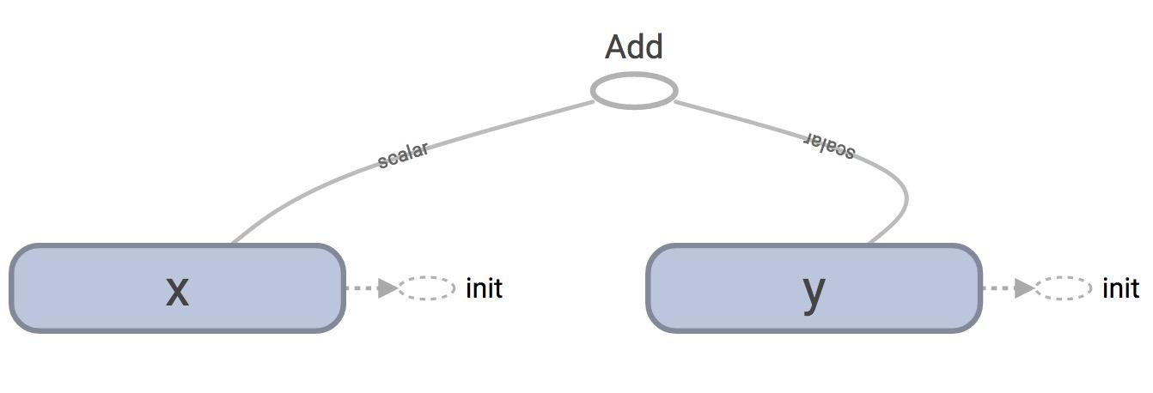
TensorBoard
Normal loading
Notes:
Looks normal

Slide 137
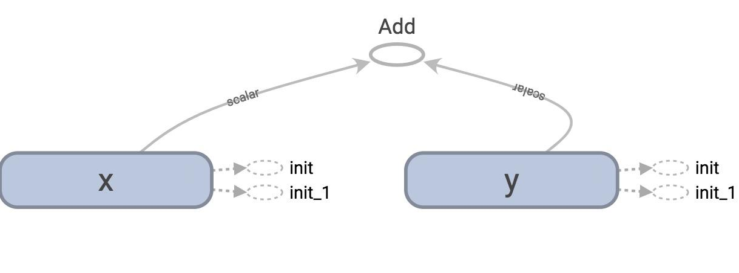
TensorBoard
Lazy loading

Slide 138
tf.get_default_graph().as_graph_def()
Normal loading
node {
name: "Add"
op: "Add"
input: "x/read"
input: "y/read"
attr {
key: "T"
value {
type: DT_INT32
}
}
}
Node “Add” added once to the graph definition
Notes:
tensorflow.python.framework.errors_impl.FailedPreconditionError: Attempting to use uninitialized value

Slide 139
tf.get_default_graph().as_graph_def()
Lazy loading
node {
name: "Add_1"
op: "Add"
...
}
...
node {
name: "Add_10"
op: "Add"
...
}
Node “Add” added 10 times to the graph definition
Or as many times as you want to compute z

Slide 140
Imagine you want to compute an op
thousands, or millions of times!
Notes:
Example from GitHub

Slide 141
Your graph gets bloated
Slow to load
Expensive to pass around
Notes:
Example from GitHub

Slide 142
One of the most common TF non-bug bugs I’ve seen on GitHub

Slide 143
Solution
Separate definition of ops from computing/running ops
Use Python property to ensure function is also loaded once the first time it is called*
* This is not a Python class so I won’t go into it here. But if you don’t know how to use this property, you’re welcome to ask me!

Slide 144
Putting it together:
Let’s build a machine learning model!
Notes:
Example from GitHub

Slide 145
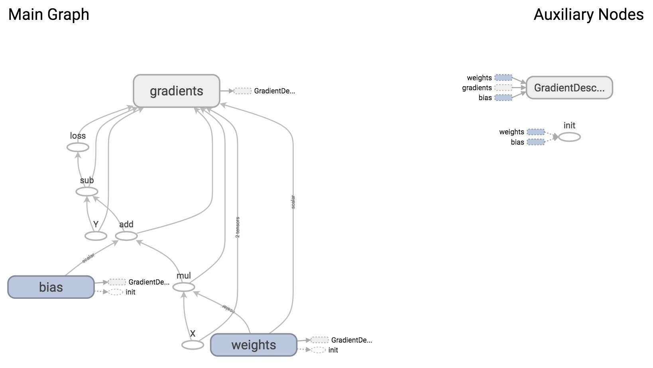
Notes:
How it looks like on TensorBoard

Slide 146
We will construct this model next time!!

Slide 147
Basic Models in TensorFlow
CS 20: TensorFlow for Deep Learning Research
Lecture 3
1/19/2017

Slide 148
Agenda
Review
Linear regression on birth/life data
Control Flow
tf.data
Optimizers, gradients
Logistic regression on MNIST
Loss functions

Slide 149
Review
Notes:
Key concepts from the previous two lectures

Slide 150
Computation graph
TensorFlow separates definition of computations from their execution
Phase 1: assemble a graph
Phase 2: use a session to execute operations in the graph.

Slide 151
TensorBoard
x = 2 y = 3 add_op = tf.add(x, y) mul_op = tf.multiply(x, y) useless = tf.multiply(x, add_op) pow_op = tf.pow(add_op, mul_op) with tf.Session() as sess: z = sess.run(pow_op)
useless
pow_op
add_op
mul_op
Create a FileWriter object to write your graph to event files

Slide 152
tf.constant and tf.Variable
Constant values are stored in the graph definition
Sessions allocate memory to store variable values

Slide 153
tf.placeholder and feed_dict
Feed values into placeholders with a dictionary (feed_dict)
Easy to use but poor performance

Slide 154
Avoid lazy loading
Separate the assembling of graph and executing ops
Use Python attribute to ensure a function is only loaded the first time it’s called

Slide 155
Download from the class’s GitHub
examples/03_linreg_starter.py
examples/03_logreg_starter.py
examples/utils.py
data/birth_life_2010.txt

Slide 156
Linear Regression
in TensorFlow

Slide 157
Model the linear relationship between:
dependent variable Y
explanatory variables X

Slide 158
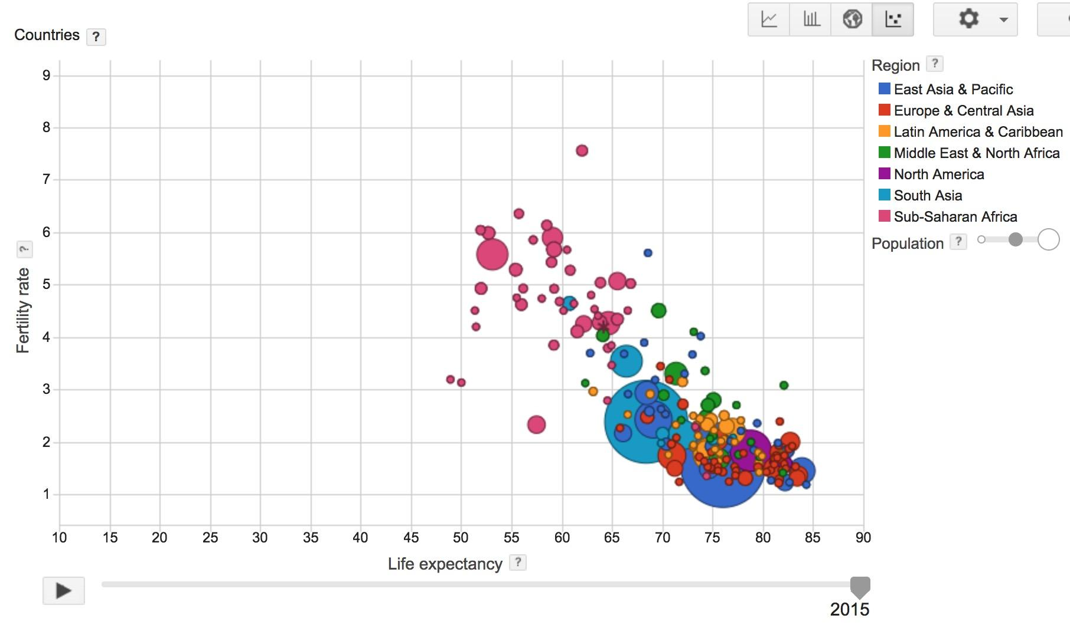
Visualization made by Google, based on data collected by World Bank

Slide 159
World Development Indicators dataset
X: birth rate
Y: life expectancy
190 countries

Slide 160
Want
Find a linear relationship between X and Y
to predict Y from X

Slide 161
Model
Inference: Y_predicted = w * X + b
Mean squared error: E[(y - y_predicted)²]

Slide 162
Interactive Coding
data/birth_life_2010.txt
Notes:
Examine data

Slide 163
Interactive Coding
examples/03_linreg_starter.py

Slide 164
Phase 1: Assemble our graph

Slide 165
Step 1: Read in data
I already did that for you

Slide 166
Step 2: Create placeholders for
inputs and labels
tf.placeholder(dtype, shape=None, name=None)

Slide 167
Step 3: Create weight and bias
tf.get_variable(
name,
shape=None,
dtype=None,
initializer=None,
…
)
No need to specify shape if
using constant initializer

Slide 168
Step 4: Inference
Y_predicted = w * X + b

Slide 169
Step 5: Specify loss function
loss = tf.square(Y - Y_predicted, name='loss')

Slide 170
Step 6: Create optimizer
opt = tf.train.GradientDescentOptimizer(learning_rate=0.001)
optimizer = opt.minimize(loss)

Slide 171
Phase 2: Train our model
Step 1: Initialize variables
Step 2: Run optimizer
(use a feed_dict to feed data into X and Y placeholders)

Slide 172
Write log files using a FileWriter
writer = tf.summary.FileWriter('./graphs/linear_reg', sess.graph)

Slide 173
See it on TensorBoard
Step 1: $ python3 03_linreg_starter.py
Step 2: $ tensorboard --logdir='./graphs'

Slide 174
TypeError?
TypeError: Fetch argument 841.0 has invalid type <class 'numpy.float32'>, must be a string or Tensor.
(Can not convert a float32 into a Tensor or Operation.)

Slide 175
TypeError
for i in range(50): # train the model 100 epochs
total_loss = 0
for x, y in data:
_, loss = sess.run([optimizer, loss], feed_dict={X: x, Y:y}) # Can’t fetch a numpy array
total_loss += loss
Notes:
How does it do so? By using graphs and sessions

Slide 176
TypeError
for i in range(50): # train the model 100 epochs
total_loss = 0
for x, y in data:
_, loss_ = sess.run([optimizer, loss], feed_dict={X: x, Y:y})
total_loss += loss_
Notes:
How does it do so? By using graphs and sessions

Slide 178
Plot the results with matplotlib
Step 1: Uncomment the plotting code at the end of your program
Step 2: Run it again
If run into problem of matplotlib in virtual environment, go to GitHub/setup and see the file possible setup problems

Slide 179
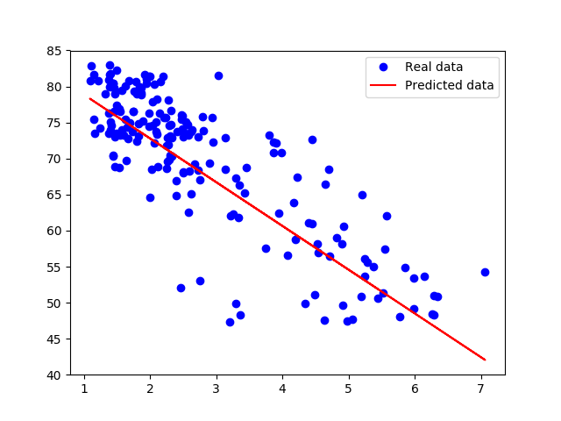

Slide 180
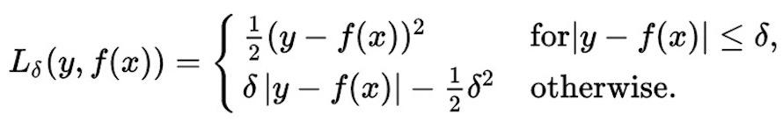
Huber loss
Robust to outliers
If the difference between the predicted value and the real value is small, square it
If it’s large, take its absolute value

Slide 181
Implementing Huber loss
Can’t write:
if y - y_predicted < delta:
You can write it if eager mode were enabled. Stay tuned for the next lecture!

Slide 182
Implementing Huber loss
tf.cond(pred, fn1, fn2, name=None)

Slide 183
Implementing Huber loss
tf.cond(pred, fn1, fn2, name=None)
def huber_loss(labels, predictions, delta=14.0): residual = tf.abs(labels - predictions) def f1(): return 0.5 * tf.square(residual) def f2(): return delta * residual - 0.5 * tf.square(delta) return tf.cond(residual < delta, f1, f2)

Slide 184
TF Control Flow
Control Flow Ops | tf.group, tf.count_up_to, tf.cond, tf.case, tf.while_loop, ...
Comparison Ops | tf.equal, tf.not_equal, tf.less, tf.greater, tf.where, ...
Logical Ops | tf.logical_and, tf.logical_not, tf.logical_or, tf.logical_xor
Debugging Ops | tf.is_finite, tf.is_inf, tf.is_nan, tf.Assert, tf.Print, ...
Since TF builds graph before computation, we have to specify all possible subgraphs beforehand.
PyTorch’s dynamic graphs and TF’s eager execution help overcome this

Slide 185
tf.data

Slide 186
Placeholder
Pro: put the data processing outside TensorFlow, making it easy to do in Python
Cons: users often end up processing their data in a single thread and creating data bottleneck that slows execution down.

Slide 187
Placeholder
data, n_samples = utils.read_birth_life_data(DATA_FILE)
X = tf.placeholder(tf.float32, name='X') Y = tf.placeholder(tf.float32, name='Y') … with tf.Session() as sess: … # Step 8: train the model for i in range(100): # run 100 epochs for x, y in data: # Session runs train_op to minimize loss sess.run(optimizer, feed_dict={X: x, Y:y})

Slide 188
tf.data
Instead of doing inference with placeholders and feeding in data later, do inference directly with data

Slide 189
tf.data
tf.data.Dataset
tf.data.Iterator

Slide 190
Store data in tf.data.Dataset
tf.data.Dataset.from_tensor_slices((features, labels))
tf.data.Dataset.from_generator(gen, output_types, output_shapes)

Slide 191
Store data in tf.data.Dataset
tf.data.Dataset.from_tensor_slices((features, labels))
dataset = tf.data.Dataset.from_tensor_slices((data[:,0], data[:,1]))

Slide 192
Store data in tf.data.Dataset
tf.data.Dataset.from_tensor_slices((features, labels))
dataset = tf.data.Dataset.from_tensor_slices((data[:,0], data[:,1]))
print(dataset.output_types) # >> (tf.float32, tf.float32)
print(dataset.output_shapes) # >> (TensorShape([]), TensorShape([]))

Slide 193
Can also create Dataset from files
tf.data.TextLineDataset(filenames)
tf.data.FixedLengthRecordDataset(filenames)
tf.data.TFRecordDataset(filenames)

Slide 194
tf.data.Iterator
Create an iterator to iterate through samples in Dataset

Slide 195
tf.data.Iterator
iterator = dataset.make_one_shot_iterator()
iterator = dataset.make_initializable_iterator()

Slide 196
tf.data.Iterator
iterator = dataset.make_one_shot_iterator() Iterates through the dataset exactly once. No need to initialization.
iterator = dataset.make_initializable_iterator() Iterates through the dataset as many times as we want. Need to initialize with each epoch.

Slide 197
tf.data.Iterator
iterator = dataset.make_one_shot_iterator() X, Y = iterator.get_next() # X is the birth rate, Y is the life expectancy
with tf.Session() as sess: print(sess.run([X, Y])) # >> [1.822, 74.82825] print(sess.run([X, Y])) # >> [3.869, 70.81949] print(sess.run([X, Y])) # >> [3.911, 72.15066]

Slide 198
tf.data.Iterator
iterator = dataset.make_initializable_iterator()
...
for i in range(100): sess.run(iterator.initializer) total_loss = 0 try: while True: sess.run([optimizer]) except tf.errors.OutOfRangeError: pass

Slide 199
Handling data in TensorFlow
dataset = dataset.shuffle(1000)
dataset = dataset.repeat(100)
dataset = dataset.batch(128)
dataset = dataset.map(lambda x: tf.one_hot(x, 10)) # convert each elem of dataset to one_hot vector

Slide 200
Does tf.data really perform better?
Notes:
s

Slide 201
Does tf.data really perform better?
With placeholder: 9.05271519 seconds
With tf.data: 6.12285947 seconds

Slide 202
Should we always use tf.data?
For prototyping, feed dict can be faster and easier to write (pythonic)
tf.data is tricky to use when you have complicated preprocessing or multiple data sources
NLP data is normally just a sequence of integers. In this case, transferring the data over to GPU is pretty quick, so the speedup of tf.data isn't that large

Slide 203
How does TensorFlow know what variables to update?
Notes:
s

Slide 204
Optimizers

Slide 205
Optimizer
optimizer = tf.train.GradientDescentOptimizer(learning_rate=0.01).minimize(loss)
_, l = sess.run([optimizer, loss], feed_dict={X: x, Y:y})

Slide 206
Optimizer
optimizer = tf.train.GradientDescentOptimizer(learning_rate=0.001).minimize(loss)
_, l = sess.run([optimizer, loss], feed_dict={X: x, Y:y})
Session looks at all trainable variables that loss depends on and update them

Slide 207
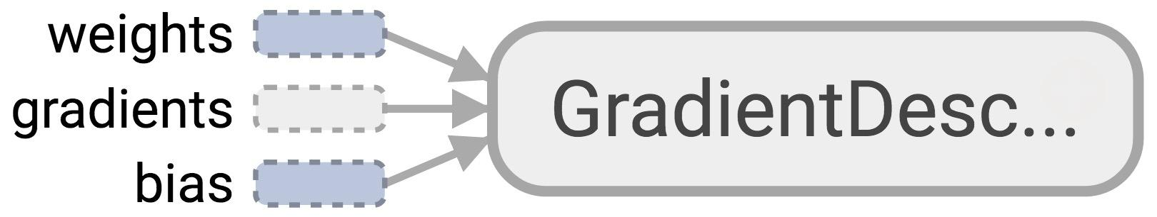
Optimizer
Session looks at all trainable variables that optimizer depends on and update them

Slide 208
Trainable variables
tf.Variable(initial_value=None, trainable=True,...)
Specify if a variable should be trained or not
By default, all variables are trainable
Notes:
For example, global_steps shouldn’t be trainable
Or in double q-learning, you want to alternate which q-value functions to update

Slide 209
List of optimizers in TF
tf.train.GradientDescentOptimizer
tf.train.AdagradOptimizer
tf.train.MomentumOptimizer
tf.train.AdamOptimizer
tf.train.FtrlOptimizer
tf.train.RMSPropOptimizer
...
“Advanced” optimizers work better when tuned, but are generally harder to tune
Notes:
RMSprop, Adagrad, and Adam are very similar algorithms that do well in similar circumstances. Kingma et al. [15] show that its bias-correction helps Adam slightly outperform RMSprop towards the end of optimization as gradients become sparser. Insofar, Adam might be the best overall choice.”

Slide 210
Discussion question
How to know that our model is correct?
How to improve our model?

Slide 211
Logistic Regression
in TensorFlow

Slide 212

Then he separated the light from the darkness
The first logistic regression model

Slide 213
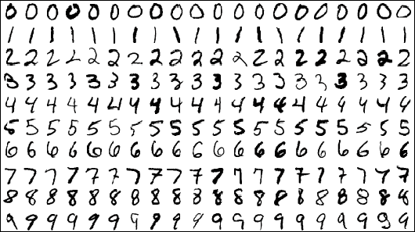
MNIST Database
Each image is a 28x28 array, flattened out to be a 1-d tensor of size 784
Notes:
Hosted on yann.lecun.com/exdb/mnist/

Slide 214
MNIST
X: image of a handwritten digit
Y: the digit value
Recognize the digit in the image

Slide 215
MNIST
X: image of a handwritten digit
Y: the digit value

Slide 216
Model
Inference: Y_predicted = softmax(X * w + b)
Cross entropy loss: -log(Y_predicted)
Notes:
Y are one-hot vectors

Slide 217
Process data
from tensorflow.examples.tutorials.mnist import input_data
MNIST = input_data.read_data_sets('data/mnist', one_hot=True)

Slide 218
Process data
from tensorflow.examples.tutorials.mnist import input_data
MNIST = input_data.read_data_sets('data/mnist', one_hot=True)
MNIST.train: 55,000 examples
MNIST.validation: 5,000 examples
MNIST.test: 10,000 examples

Slide 219
Process data
from tensorflow.examples.tutorials.mnist import input_data
MNIST = input_data.read_data_sets('data/mnist', one_hot=True)
MNIST.train: 55,000 examples
MNIST.validation: 5,000 examples
MNIST.test: 10,000 examples
No immediate way to convert Python generators to tf.data.Dataset

Slide 220
Process data
mnist_folder = 'data/mnist'
utils.download_mnist(mnist_folder)
train, val, test = utils.read_mnist(mnist_folder, flatten=True)

Slide 221
Create datasets
mnist_folder = 'data/mnist'
utils.download_mnist(mnist_folder)
train, val, test = utils.read_mnist(mnist_folder, flatten=True)
train_data = tf.data.Dataset.from_tensor_slices(train) train_data = train_data.shuffle(10000) # optional
test_data = tf.data.Dataset.from_tensor_slices(test)

Slide 222
Create iterator
mnist_folder = 'data/mnist'
utils.download_mnist(mnist_folder)
train, val, test = utils.read_mnist(mnist_folder, flatten=True)
train_data = tf.data.Dataset.from_tensor_slices(train) train_data = train_data.shuffle(10000) # optional
test_data = tf.data.Dataset.from_tensor_slices(test)
iterator = train_data.make_initializable_iterator()

Slide 223
Create iterator
mnist_folder = 'data/mnist'
utils.download_mnist(mnist_folder)
train, val, test = utils.read_mnist(mnist_folder, flatten=True)
train_data = tf.data.Dataset.from_tensor_slices(train) train_data = train_data.shuffle(10000) # optional
test_data = tf.data.Dataset.from_tensor_slices(test)
iterator = train_data.make_initializable_iterator()
img, label = iterator.get_next()
…
Problem?

Slide 224
Create iterator
mnist_folder = 'data/mnist'
utils.download_mnist(mnist_folder)
train, val, test = utils.read_mnist(mnist_folder, flatten=True)
train_data = tf.data.Dataset.from_tensor_slices(train) train_data = train_data.shuffle(10000) # optional
test_data = tf.data.Dataset.from_tensor_slices(test)
iterator = train_data.make_initializable_iterator()
img, label = iterator.get_next()
…
>> Can only do inference with train_data.
>> Need to build another subgraph with another iterator for test_data!!!

Slide 225
Create iterator
mnist_folder = 'data/mnist'
utils.download_mnist(mnist_folder)
train, val, test = utils.read_mnist(mnist_folder, flatten=True)
train_data = tf.data.Dataset.from_tensor_slices(train) train_data = train_data.shuffle(10000) # optional
test_data = tf.data.Dataset.from_tensor_slices(test)
iterator = tf.data.Iterator.from_structure(train_data.output_types,
train_data.output_shapes)
img, label = iterator.get_next()
train_init = iterator.make_initializer(train_data) # initializer for train_data
test_init = iterator.make_initializer(test_data) # initializer for train_data
Notes:
Creating an iterator with different initializers!

Slide 226
Initialize iterator with the dataset you want
with tf.Session() as sess:
...
for i in range(n_epochs):
sess.run(train_init) # use train_init during training loop
try:
while True:
_, l = sess.run([optimizer, loss])
except tf.errors.OutOfRangeError:
pass
Notes:
Creating an iterator with different initializers!

Slide 227
Initialize iterator with the dataset you want
with tf.Session() as sess:
...
for i in range(n_epochs):
sess.run(train_init)
try:
while True:
_, l = sess.run([optimizer, loss])
except tf.errors.OutOfRangeError:
pass
# test the model
sess.run(test_init) # use test_init during testing
try:
while True:
sess.run(accuracy)
except tf.errors.OutOfRangeError:
pass
Notes:
Creating an iterator with different initializers!

Slide 228
Phase 1: Assemble our graph

Slide 229
Step 1: Read in data
I already did that for you

Slide 230
Step 2: Create datasets and iterator
train_data = tf.data.Dataset.from_tensor_slices(train) train_data = train_data.shuffle(10000) # optional train_data = train_data.batch(batch_size)
test_data = tf.data.Dataset.from_tensor_slices(test) test_data = test_data.batch(batch_size)

Slide 231
Step 2: Create datasets and iterator
iterator = tf.data.Iterator.from_structure(train_data.output_types, train_data.output_shapes) img, label = iterator.get_next()
train_init = iterator.make_initializer(train_data) test_init = iterator.make_initializer(test_data)

Slide 232
Step 3: Create weights and biases
use tf.get_variable()

Slide 233
Step 4: Build model to predict Y
logits = tf.matmul(img, w) + b
We don’t do softmax here, as we’ll do softmax together with cross_entropy loss.
It’s more efficient to compute gradients w.r.t. logits than w.r.t. softmax

Slide 234
Step 5: Specify loss function
entropy = tf.nn.softmax_cross_entropy_with_logits(labels=label, logits=logits)
loss = tf.reduce_mean(entropy)

Slide 235
Step 6: Create optimizer
tf.train.AdamOptimizer(learning_rate=0.01).minimize(loss)

Slide 236
Phase 2: Train our model
Step 1: Initialize variables
Step 2: Run optimizer op

Slide 237
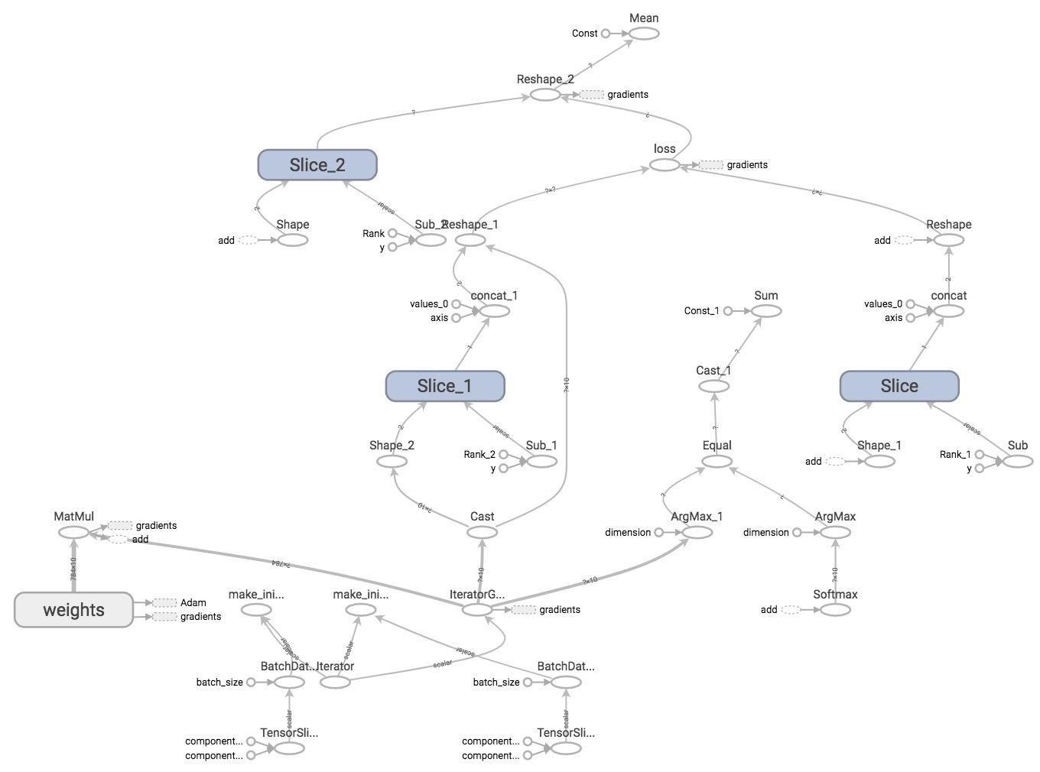
TensorBoard it

Slide 238
Manage Experiments
CS 20: TensorFlow for Deep Learning Research
Lecture 5
1/26/2017

Slide 239
Agenda
word2vec
Embedding visualization
Structure your TensorFlow model
Variable sharing
Manage experiments
Autodiff

Slide 240
Variable sharing

Slide 241
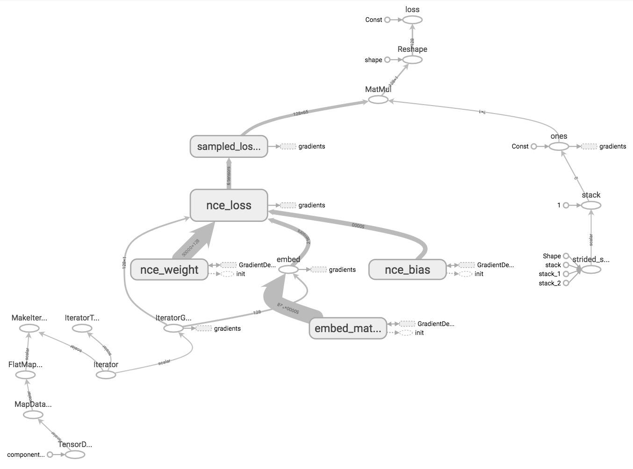
word2vec on TensorBoard

Slide 242
word2vec on TensorBoard
What if I have more complex models?

Slide 243
Name scope
TensorFlow doesn’t know what nodes should be grouped together, unless you tell it to

Slide 244
Name scope
Group nodes together with tf.name_scope(name)
with tf.name_scope(name_of_that_scope):
# declare op_1
# declare op_2
# ...

Slide 245
Name scope
with tf.name_scope('data'): iterator = dataset.make_initializable_iterator() center_words, target_words = iterator.get_next()
with tf.name_scope('embed'): embed_matrix = tf.get_variable('embed_matrix', shape=[VOCAB_SIZE, EMBED_SIZE], ...) embed = tf.nn.embedding_lookup(embed_matrix, center_words)
with tf.name_scope('loss'): nce_weight = tf.get_variable('nce_weight', shape=[VOCAB_SIZE, EMBED_SIZE], ...) nce_bias = tf.get_variable('nce_bias', initializer=tf.zeros([VOCAB_SIZE])) loss = tf.reduce_mean(tf.nn.nce_loss(weights=nce_weight, biases=nce_bias, …)
with tf.name_scope('optimizer'): optimizer = tf.train.GradientDescentOptimizer(LEARNING_RATE).minimize(loss)

Slide 246
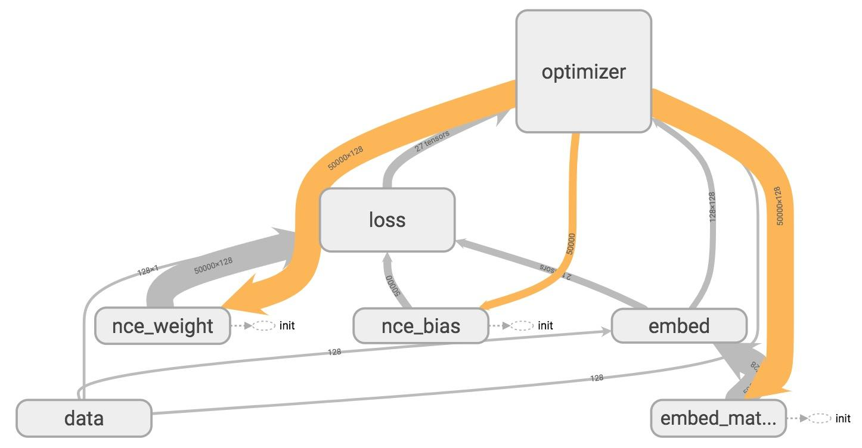
TensorBoard

Slide 247
Variable scope
Name scope vs variable scope
tf.name_scope() vs tf.variable_scope()

Slide 248
Variable scope
Name scope vs variable scope
Variable scope facilitates variable sharing

Slide 249
Variable sharing: The problem
def two_hidden_layers(x):
w1 = tf.Variable(tf.random_normal([100, 50]), name='h1_weights')
b1 = tf.Variable(tf.zeros([50]), name='h1_biases')
h1 = tf.matmul(x, w1) + b1
w2 = tf.Variable(tf.random_normal([50, 10]), name='h2_weights')
b2 = tf.Variable(tf.zeros([10]), name='2_biases')
logits = tf.matmul(h1, w2) + b2
return logits

Slide 250
Variable sharing: The problem
def two_hidden_layers(x):
w1 = tf.Variable(tf.random_normal([100, 50]), name='h1_weights')
b1 = tf.Variable(tf.zeros([50]), name='h1_biases')
h1 = tf.matmul(x, w1) + b1
w2 = tf.Variable(tf.random_normal([50, 10]), name='h2_weights')
b2 = tf.Variable(tf.zeros([10]), name='2_biases')
logits = tf.matmul(h1, w2) + b2
return logits
logits1 = two_hidden_layers(x1)
logits2 = two_hidden_layers(x2)
What will happen if we make these two calls?

Slide 251
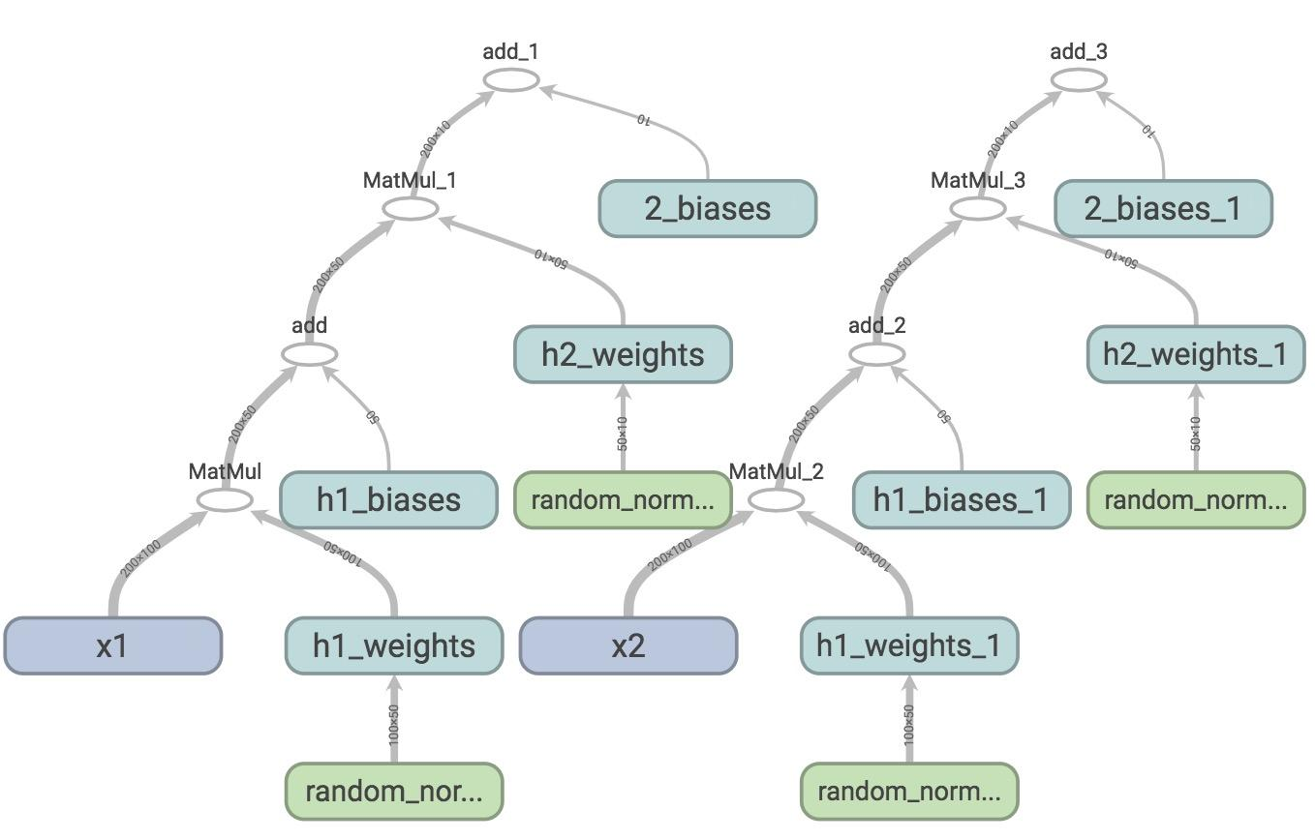
Sharing Variable: The problem
Two sets of variables are created.
You want all your inputs to use the same weights and biases!

Slide 252
tf.get_variable()
tf.get_variable(<name>, <shape>, <initializer>)
If a variable with <name> already exists, reuse it
If not, initialize it with <shape> using <initializer>

Slide 253
tf.get_variable()
def two_hidden_layers(x):
assert x.shape.as_list() == [200, 100]
w1 = tf.get_variable("h1_weights", [100, 50], initializer=tf.random_normal_initializer())
b1 = tf.get_variable("h1_biases", [50], initializer=tf.constant_initializer(0.0))
h1 = tf.matmul(x, w1) + b1
assert h1.shape.as_list() == [200, 50]
w2 = tf.get_variable("h2_weights", [50, 10], initializer=tf.random_normal_initializer())
b2 = tf.get_variable("h2_biases", [10], initializer=tf.constant_initializer(0.0))
logits = tf.matmul(h1, w2) + b2
return logits
logits1 = two_hidden_layers(x1)
logits2 = two_hidden_layers(x2)

Slide 254
tf.get_variable()
def two_hidden_layers(x):
assert x.shape.as_list() == [200, 100]
w1 = tf.get_variable("h1_weights", [100, 50], initializer=tf.random_normal_initializer())
b1 = tf.get_variable("h1_biases", [50], initializer=tf.constant_initializer(0.0))
h1 = tf.matmul(x, w1) + b1
assert h1.shape.as_list() == [200, 50]
w2 = tf.get_variable("h2_weights", [50, 10], initializer=tf.random_normal_initializer())
b2 = tf.get_variable("h2_biases", [10], initializer=tf.constant_initializer(0.0))
logits = tf.matmul(h1, w2) + b2
return logits
logits1 = two_hidden_layers(x1)
logits2 = two_hidden_layers(x2)
ValueError: Variable h1_weights already exists, disallowed. Did you mean to set reuse=True in VarScope?

Slide 255
tf.variable_scope()
def two_hidden_layers(x):
assert x.shape.as_list() == [200, 100]
w1 = tf.get_variable("h1_weights", [100, 50], initializer=tf.random_normal_initializer())
b1 = tf.get_variable("h1_biases", [50], initializer=tf.constant_initializer(0.0))
h1 = tf.matmul(x, w1) + b1
assert h1.shape.as_list() == [200, 50]
w2 = tf.get_variable("h2_weights", [50, 10], initializer=tf.random_normal_initializer())
b2 = tf.get_variable("h2_biases", [10], initializer=tf.constant_initializer(0.0))
logits = tf.matmul(h1, w2) + b2
return logits
with tf.variable_scope('two_layers') as scope:
logits1 = two_hidden_layers(x1)
scope.reuse_variables()
logits2 = two_hidden_layers(x2)
Put your variables within a scope and reuse all variables within that scope

Slide 256
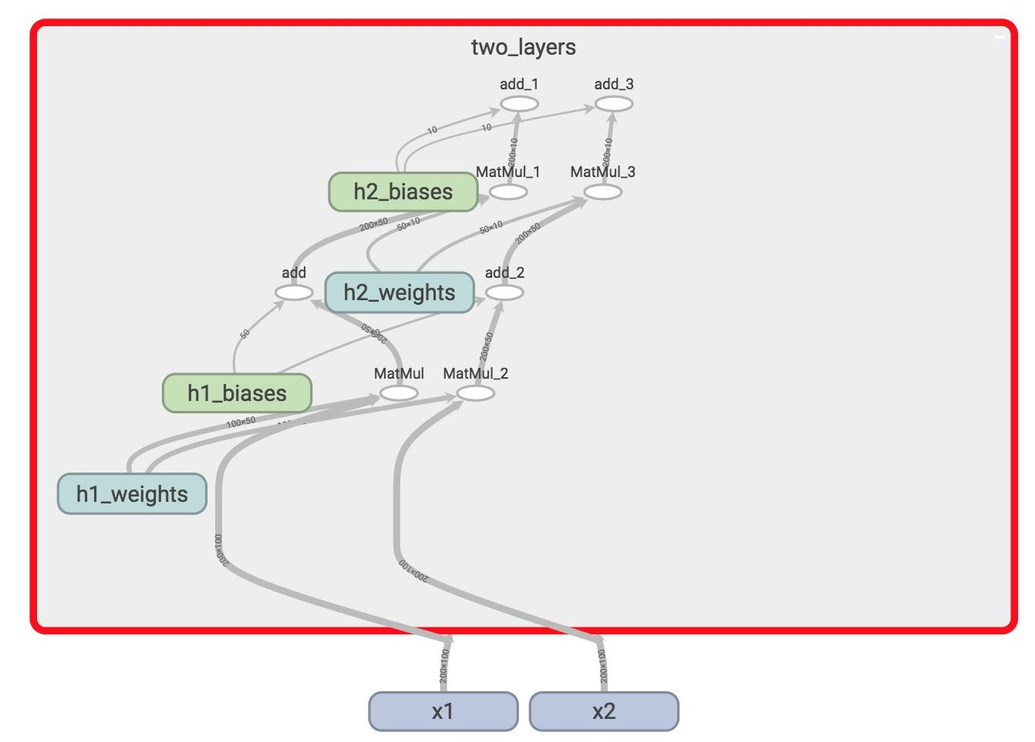
tf.variable_scope()
Only one set of variables, all within the variable scope “two_layers”
They take in two different inputs

Slide 257
tf.variable_scope()
tf.variable_scope implicitly creates a name scope

Slide 258
Reusable code?
def two_hidden_layers(x):
assert x.shape.as_list() == [200, 100]
w1 = tf.get_variable("h1_weights", [100, 50], initializer=tf.random_normal_initializer())
b1 = tf.get_variable("h1_biases", [50], initializer=tf.constant_initializer(0.0))
h1 = tf.matmul(x, w1) + b1
assert h1.shape.as_list() == [200, 50]
w2 = tf.get_variable("h2_weights", [50, 10], initializer=tf.random_normal_initializer())
b2 = tf.get_variable("h2_biases", [10], initializer=tf.constant_initializer(0.0))
logits = tf.matmul(h1, w2) + b2
return logits
with tf.variable_scope('two_layers') as scope:
logits1 = two_hidden_layers(x1)
scope.reuse_variables()
logits2 = two_hidden_layers(x2)

Slide 259
Layer ‘em up
def fully_connected(x, output_dim, scope):
with tf.variable_scope(scope, reuse=tf.AUTO_REUSE) as scope:
w = tf.get_variable("weights", [x.shape[1], output_dim], initializer=tf.random_normal_initializer())
b = tf.get_variable("biases", [output_dim], initializer=tf.constant_initializer(0.0))
return tf.matmul(x, w) + b
def two_hidden_layers(x):
h1 = fully_connected(x, 50, 'h1')
h2 = fully_connected(h1, 10, 'h2')
with tf.variable_scope('two_layers') as scope:
logits1 = two_hidden_layers(x1)
logits2 = two_hidden_layers(x2)
Fetch variables if they already exist
Else, create them

Slide 260
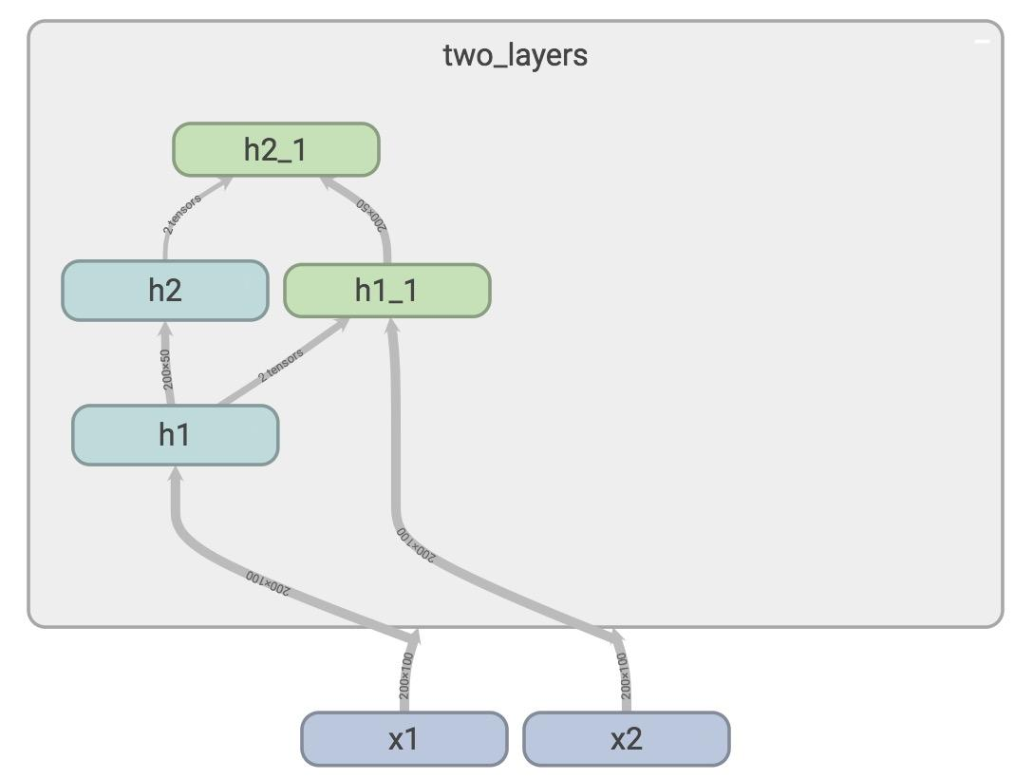
Layer ‘em up

Slide 261
Manage Experiments

Slide 262
tf.train.Saver
saves graph’s variables in binary files
Notes:
A good practice is to periodically save the model’s parameters after a certain number of steps so that we can restore/retrain our model from that step if need be. The tf.train.Saver() class allows us to do so by saving the graph’s variables in binary files.

Slide 263
Saves sessions, not graphs!
tf.train.Saver.save(sess, save_path, global_step=None...)
tf.train.Saver.restore(sess, save_path)

Slide 264
Save parameters after 1000 steps
# define model
model = SkipGramModel(params)
# create a saver object
saver = tf.train.Saver()
with tf.Session() as sess:
for step in range(training_steps):
sess.run([optimizer])
# save model every 1000 steps
if (step + 1) % 1000 == 0:
saver.save(sess,
'checkpoint_directory/model_name',
global_step=step)

Slide 265
Specify the step at which the model is saved
# define model
model = SkipGramModel(params)
# create a saver object
saver = tf.train.Saver()
with tf.Session() as sess:
for step in range(training_steps):
sess.run([optimizer])
# save model every 1000 steps
if (step + 1) % 1000 == 0:
saver.save(sess,
'checkpoint_directory/model_name',
global_step=step)
Notes:
In TensorFlow lingo, the step at which you save your graph’s variables is called a checkpoint. Since we will be creating many checkpoints, it’s helpful to append the number of training steps our model has gone through in a variable called global_step. It’s a very common variable to see in TensorFlow program. We first need to create it, initialize it to 0 and set it to be not trainable, since we don’t want to TensorFlow to optimize it.

Slide 266
Global step
global_step = tf.Variable(0, dtype=tf.int32, trainable=False, name='global_step')
Very common in TensorFlow program
Notes:
Trainable is false

Slide 267
Global step
global_step = tf.Variable(0,
dtype=tf.int32,
trainable=False,
name='global_step')
optimizer = tf.train.AdamOptimizer(lr).minimize(loss, global_step=global_step)
Need to tell optimizer to increment global step
This can also help your optimizer know when to decay learning rate

Slide 268
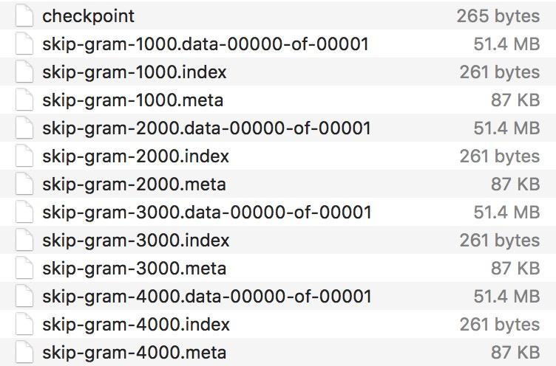
Your checkpoints are saved in checkpoint_directory
Notes:
Trainable is false. if you use decay learning rate, of course

Slide 269
tf.train.Saver
Only save variables, not graph
Checkpoints map variable names to tensors
Notes:
Still need to build your graph

Slide 270
tf.train.Saver
Can also choose to save certain variables
v1 = tf.Variable(..., name='v1')
v2 = tf.Variable(..., name='v2')
You can save your variables in one of three ways:
saver = tf.train.Saver({'v1': v1, 'v2': v2})
saver = tf.train.Saver([v1, v2])
saver = tf.train.Saver({v.op.name: v for v in [v1, v2]}) # similar to a dict

Slide 271
Restore variables
saver.restore(sess, 'checkpoints/name_of_the_checkpoint')
e.g. saver.restore(sess, 'checkpoints/skip-gram-99999')
Still need to first build graph

Slide 272
Restore the latest checkpoint
# check if there is checkpoint
ckpt = tf.train.get_checkpoint_state(os.path.dirname('checkpoints/checkpoint'))
# check if there is a valid checkpoint path
if ckpt and ckpt.model_checkpoint_path:
saver.restore(sess, ckpt.model_checkpoint_path)
checkpoint file keeps track of the latest checkpoint
restore checkpoints only when there is a valid checkpoint path

Slide 273
tf.summary
Why matplotlib when you can summarize?

Slide 274
tf.summary
Visualize our summary statistics during our training
tf.summary.scalar
tf.summary.histogram
tf.summary.image

Slide 275
Step 1: create summaries
with tf.name_scope("summaries"):
tf.summary.scalar("loss", self.loss)
tf.summary.scalar("accuracy", self.accuracy)
tf.summary.histogram("histogram loss", self.loss)
summary_op = tf.summary.merge_all()
merge them all into one summary op to make managing them easier

Slide 276
Step 2: run them
loss_batch, _, summary = sess.run([loss,
optimizer,
summary_op])
Like everything else in TF, summaries are ops.
For the summaries to be built, you have to run it in a session

Slide 277
Step 3: write summaries to file
writer.add_summary(summary, global_step=step)
Need global step here so the model knows what summary corresponds to what step

Slide 278
Putting it together
tf.summary.scalar("loss", self.loss)
tf.summary.histogram("histogram loss", self.loss)
summary_op = tf.summary.merge_all()
saver = tf.train.Saver() # defaults to saving all variables
with tf.Session() as sess:
sess.run(tf.global_variables_initializer())
ckpt = tf.train.get_checkpoint_state(os.path.dirname('checkpoints/checkpoint'))
if ckpt and ckpt.model_checkpoint_path:
saver.restore(sess, ckpt.model_checkpoint_path)
writer = tf.summary.FileWriter('./graphs', sess.graph)
for index in range(10000):
...
loss_batch, _, summary = sess.run([loss, optimizer, summary_op])
writer.add_summary(summary, global_step=index)
if (index + 1) % 1000 == 0:
saver.save(sess, 'checkpoints/skip-gram', index)

Slide 279
See summaries on TensorBoard
Notes:
Live visualization

Slide 280
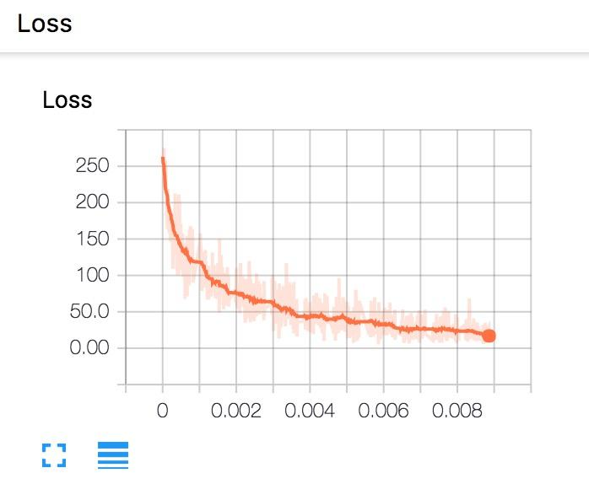
Scalar loss

Slide 281
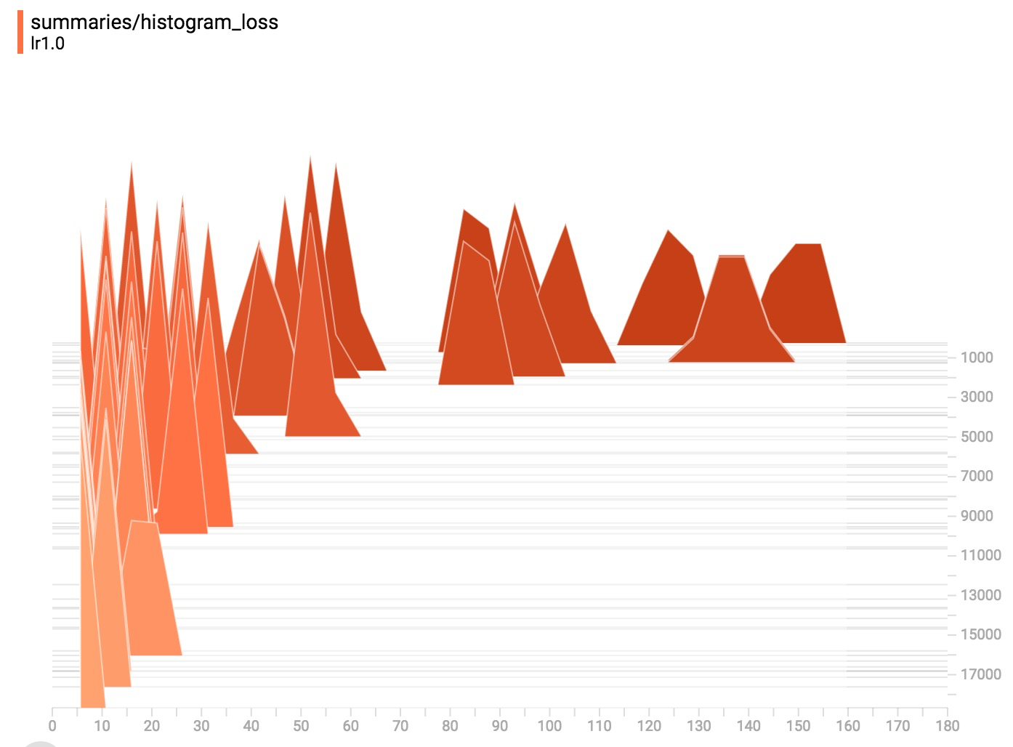
Histogram loss

Slide 282
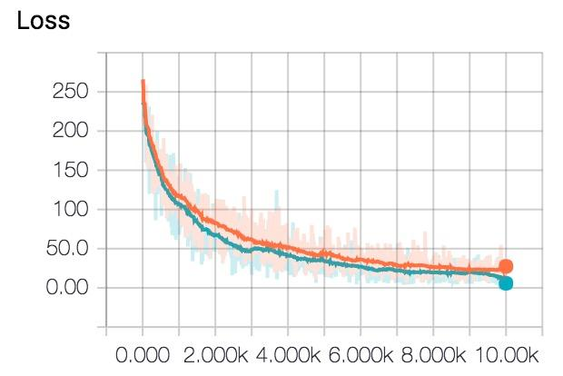
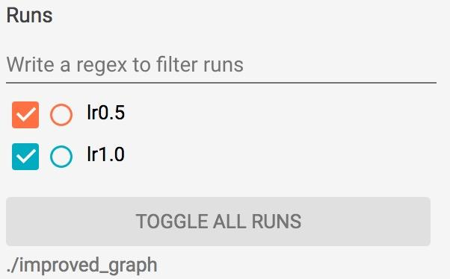
Toggle run to compare experiments
Notes:
If you save your summaries into different sub-folder in your graph folder, you can compare your progresses. For example, the first time we run our model with learning rate 1.0, we save it in ‘improved_graph/lr1.0’ and the second time we run our model, we save it in ‘improved_graph/lr0.5’

Slide 283
Control Randomization
Notes:
We need to

Slide 284
Op level random seed
my_var = tf.Variable(tf.truncated_normal((-1.0,1.0), stddev=0.1, seed=0))

Slide 285
Sessions keep track of random state
c = tf.random_uniform([], -10, 10, seed=2)
with tf.Session() as sess:
print(sess.run(c)) # >> 3.57493
print(sess.run(c)) # >> -5.97319
----
c = tf.random_uniform([], -10, 10, seed=2)
with tf.Session() as sess:
print(sess.run(c)) # >> 3.57493
with tf.Session() as sess:
print(sess.run(c)) # >> 3.57493
Each new session restarts the random state

Slide 286
Op level seed: each op keeps its own seed
c = tf.random_uniform([], -10, 10, seed=2)
d = tf.random_uniform([], -10, 10, seed=2)
with tf.Session() as sess:
print(sess.run(c)) # >> 3.57493
print(sess.run(d)) # >> 3.57493

Slide 287
Graph level seed
tf.set_random_seed(2)
c = tf.random_uniform([], -10, 10)
d = tf.random_uniform([], -10, 10)
with tf.Session() as sess:
print(sess.run(c)) # >> -4.00752
print(sess.run(d)) # >> -2.98339
Note that the result is different from op-level seed
Notes:
Example (live coding)

Slide 288
Autodiff

Slide 289
Where are the gradients?
Notes:
We have built 3 models so far and we haven’t taken a single gradient. All we needed to do was to specify the forward path and boom, we’re done.
For example, if tensor C depends on a set of previous nodes, the gradient of C with respect to those previous nodes can be automatically computed with a built-in function, even if there are many layers in between them.

Slide 290
TensorFlow builds the backward path for you!
Notes:
Path between two tensors

Slide 291
Reverse mode automatic differentiation
The computation graph makes computing symbolic gradients straightforward
Chain rule
Notes:
Path between two tensors

Slide 292
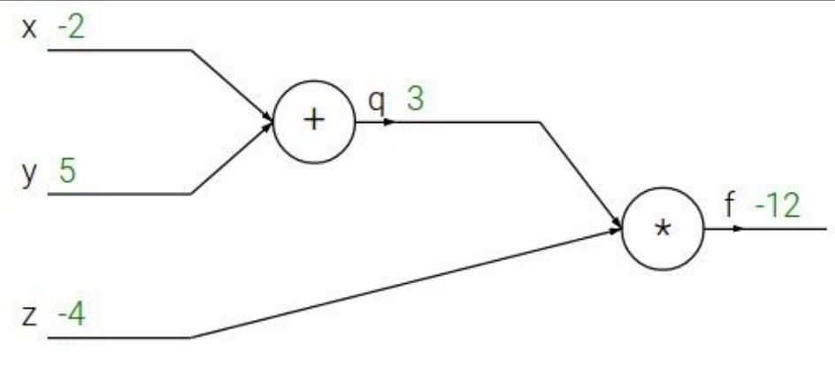
Can you take gradients for this graph?
1
Notes:
Path between two tensors

Slide 293
Reverse mode automatic differentiation
-4
-4
-4
1
3
Notes:
Path between two tensors

Slide 294
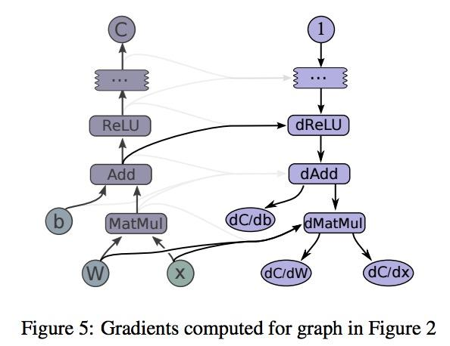
Reverse mode automatic differentiation

Slide 295
Reverse mode automatic differentiation
The backward path takes the same time as forward path

Slide 296
tf.gradients(y, [xs])
Take derivative of y with respect to each tensor
in the list [xs]
Notes:
Gradient checker
[f(x+e)-f(x-e)]/(2e)

Slide 297
tf.gradients(y, [xs])
x = tf.Variable(2.0)
y = 2.0 * (x ** 3)
z = 3.0 + y ** 2
grad_z = tf.gradients(z, [x, y])
with tf.Session() as sess:
sess.run(x.initializer)
print(sess.run(grad_z)) # >> [768.0, 32.0]
# 768 is the gradient of z with respect to x, 32 with respect to y
Notes:
Gradient checker
[f(x+e)-f(x-e)]/(2e)

Slide 298
Gradient Computation
tf.gradients(ys, xs, grad_ys=None, ...)
tf.stop_gradient(input, name=None)
# prevents the contribution of its inputs to be taken into account
tf.clip_by_value(t, clip_value_min, clip_value_max, name=None)
tf.clip_by_norm(t, clip_norm, axes=None, name=None)

Slide 299
Should I still learn to take gradients?
Notes:
Is it going to be obsolete like trying to take square root of something after the invention of calculator?

Slide 300
Yes

Slide 301
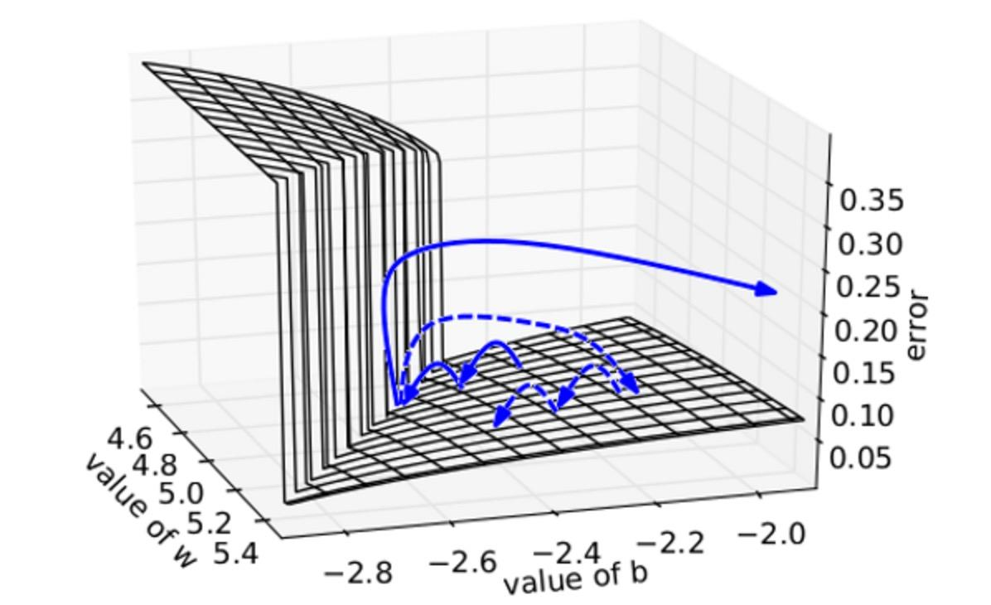
Vanishing/exploding gradients
Plot by “Understanding the exploding gradient problem”, Pascanu et al. (2012)
Notes:
Traditional activation functions such as the hyperbolic tangent function have gradients in the range (−1, 1) or [0, 1), and backpropagation computes gradients by the chain rule. This has the effect of multiplying n of these small numbers to compute gradients of the "front" layers in an n-layer network, meaning that the gradient (error signal) decreases exponentially with n and the front layers train very slowly.

